Slide 1
We help you help them.
You’re there for children and young people with epilepsy.
We are too.

Slide 2
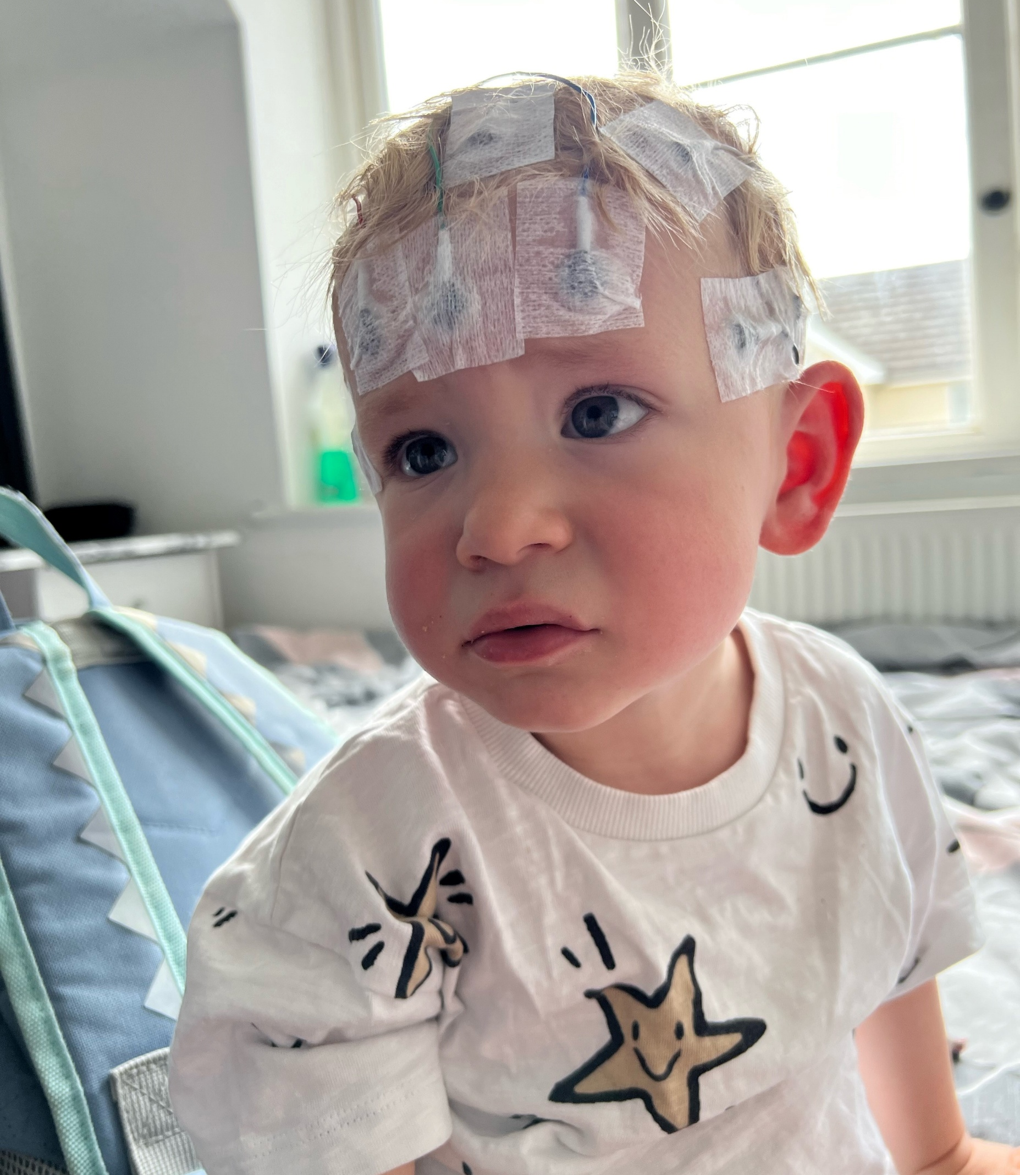
Childhood epilepsy is different
Epilepsy for children and young people affects a brain and a person who is still growing.
Balancing seizures, medications and treatments all while trying to learn, find friends and figure out who they are means epilepsy becomes part of growing up.
That makes childhood epilepsy different, and that's difference is why we exist.
Notes:
Epilepsy in childhood and young adulthood is different.
From infancy, through childhood, education and beyond - their bodies and brains are growing and changing.
Their lives are forming and evolving at home, at school, with family and friends.
And they have epilepsy. A scary, unpredictable, lonely condition.
This is why we exist.
And why we do things differently.
We see epilepsy through their eyes.

Slide 3
What we know
For many, diagnosis is frightening and overwhelming.
Children and families are left searching for answers to life‑changing questions. As children grow, those questions evolve, from school and friendships to sleep, sport, relationships, work and independence, especially when seizure control is uncertain.
Epilepsy is rarely a straight line.
Finding the right medication and treatment takes time. As children grow, seizures can change without warning. Progress can become setback; certainty can turn into doubt, an exhausting reality for young people and families.
Too often, available information isn’t built for them.
It’s written for adults, using complex medical language that children, young people, and often parents, can’t easily understand or explain to others.
That’s why we do things differently...
Notes:
What we know
Diagnosis can be frightening and overwhelming, for the child and their family. And it is often the beginning of the journey, with no straight answers or solutions.
As their bodies and life stages change so can their condition and the support they need.
It isn’t only about seizures, it impacts all aspects of the lives, at home, with friends, at school.
Epilepsy is rarely a straight line, because seizures are under control now, doesn’t mean they always will be, their can be setbacks.
Understanding the condition is key to them accepting and living well with their diagnosis, but too often information and support isn’t created for them, and is difficult to understand.

Slide 4
How we do things differently
Epilepsy touches every part of growing up. That’s why, at YOUNG Epilepsy:
We start with young people.
Everything we do is shaped by what growing up with the epilepsy is really like, for them.
Support that grows as they grow.
Epilepsy doesn’t stay the same. Our support evolves as they grow and their needs change.
No one faces epilepsy alone.
We bring young people and families together, building community, confidence and belonging.
Information that makes sense to them. Co-created with young people and families to be relevant, reassuring and easy to understand.
Everyday life safer and more inclusive.
We help health professionals connect children and young people with the support and community they need.
Notes:
This is why Young Epilepsy do things differently!
We always start with children and young people. They shape everything we do, from strategic direction, to cocreation of products and services.
We offer support that is relevant to their life stage, it evolves with them as they grow.
They can be a part of a community of young people who get what it is like, and they can connect, share and just be themselves.
Information and tools created with them for them.

Slide 5

Information, support and a community that gets it
Working together to offer a wraparound approach so families never feel alone, and you have trusted support and resources to signpost at every stage.
Notes:
So now let’s look at what we offer at Young Epilepsy…

Slide 6
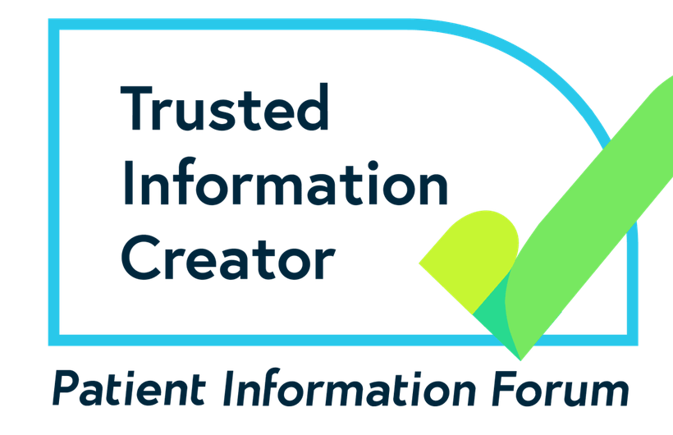
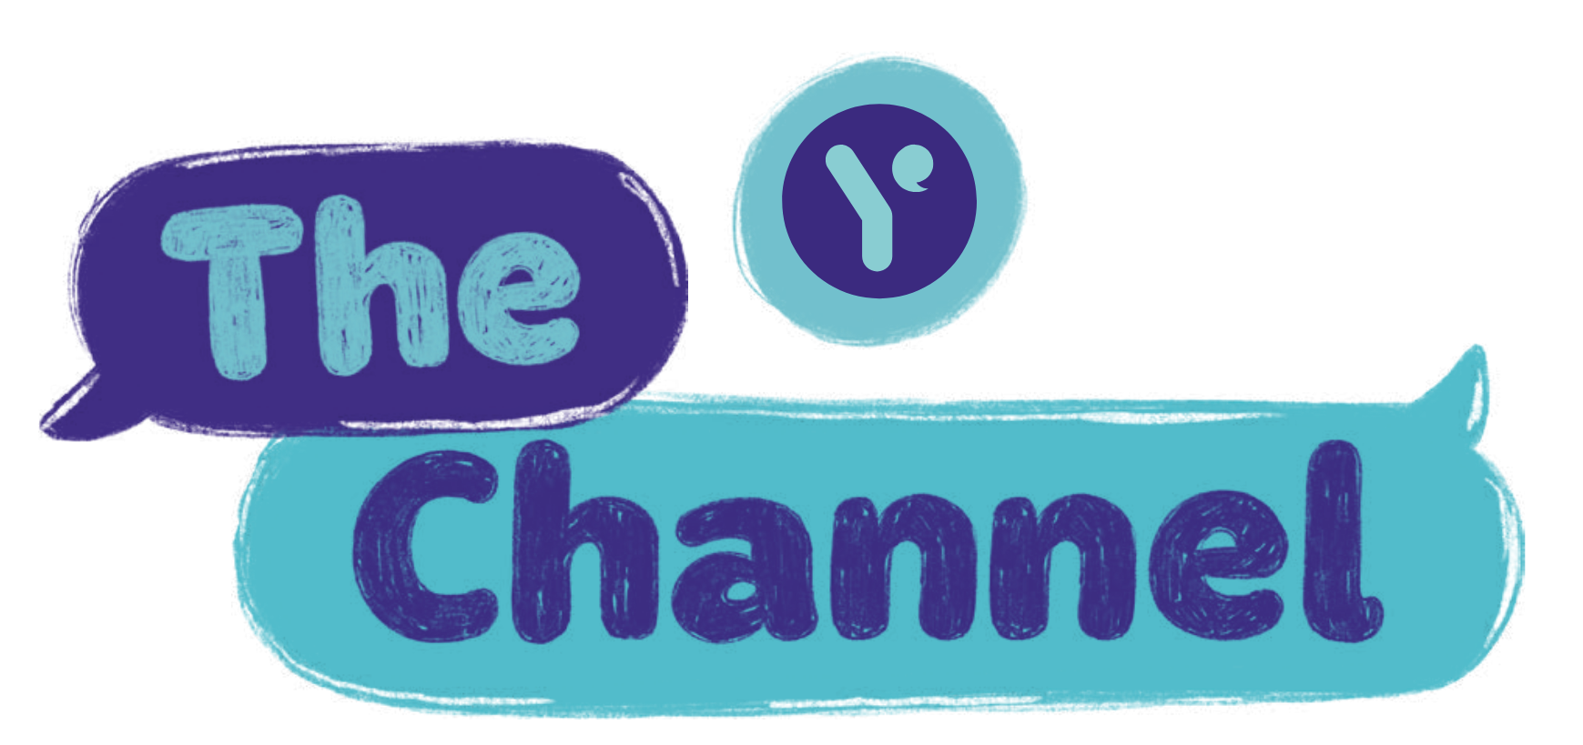
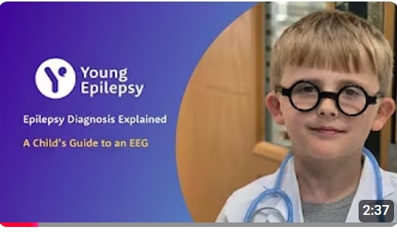
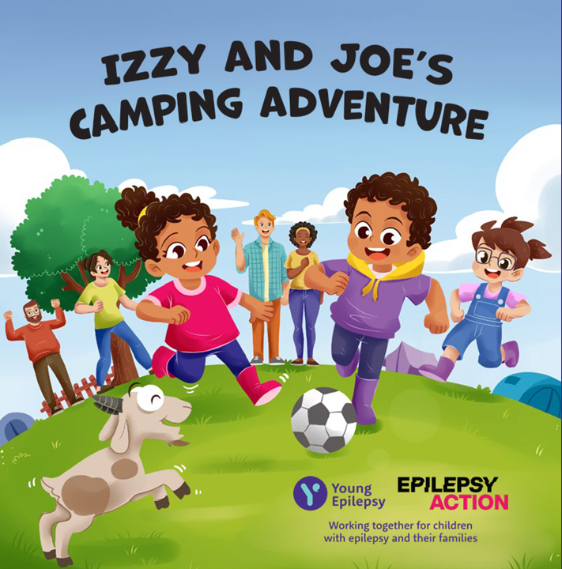
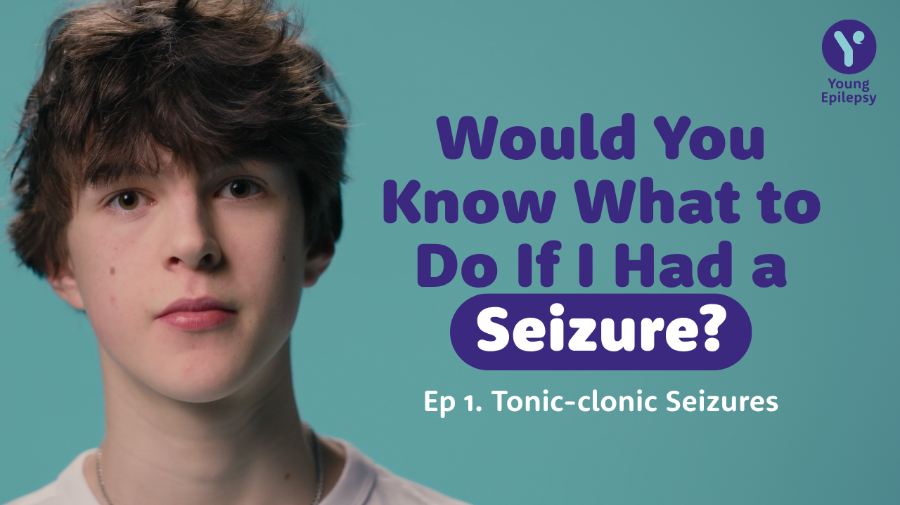
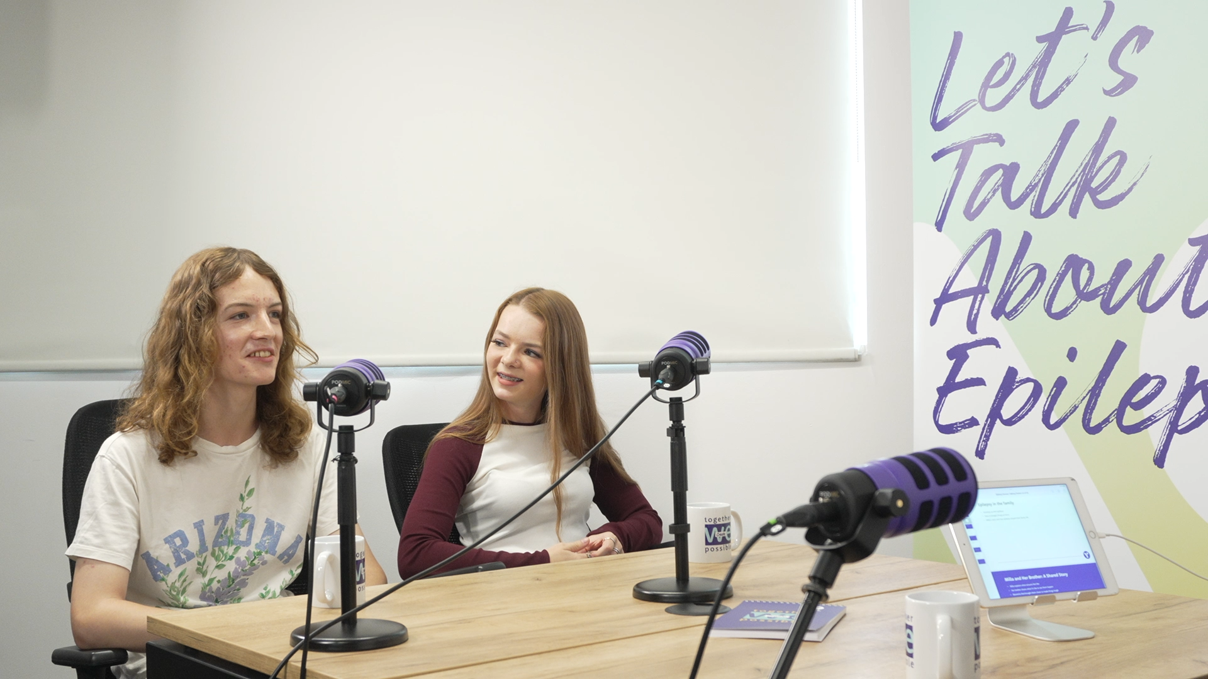

Information
Health information you can use in clinic and at follow-ups, all designed to help families feel more informed, confident and less overwhelmed.
Coming soon …
Just diagnosed
Know your meds
Ask us anything
Notes:
These are just a few of the newer things available on the website, YouTube and other streaming platforms:
EEG films to prepare them in an age appropriate way
You Can Help films to help them explain their seizure type and how people can help
Let’s Talk About Epilepsy podcast discussing the topics that are important to them and their families
Children's book for 4-8 year olds
The Channel a digital space for young people to learn, share and connect
There is a new ‘Health Professionals’ page where you can easily find these.
QR code at the end of the presentation.
Coming soon
MyMind – the new self-help wellbeing tool
Just diagnosed solution to support them from the start
Know your meds tool to understanding anti seizure meds better
Ask us anything videos for 8-12 years to hear from their peers the answers to their questions

Slide 7
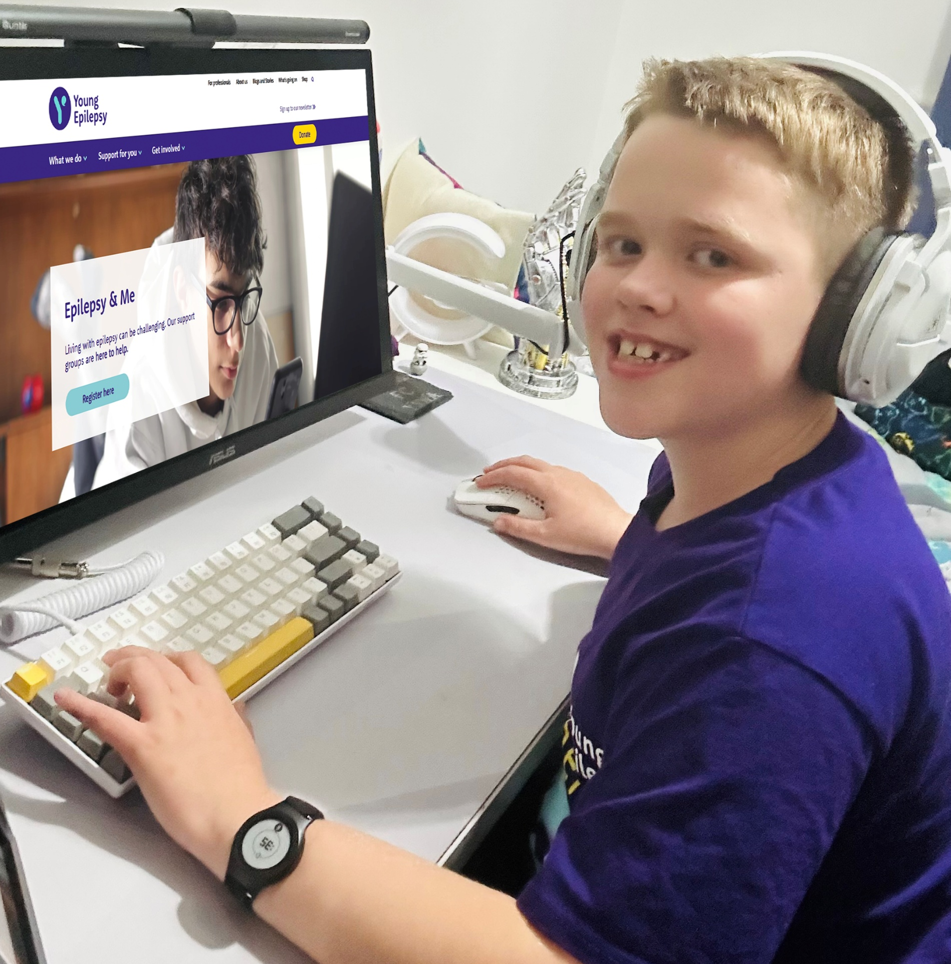

Direct Support
We support young people to better understand their epilepsy, manage challenges such as anxiety or exams, build confidence and resilience, and connect them with others who understand what life with epilepsy can feel like.
One-to-One Support:
Personalised, one-to-one support, online with a youth worker for children and young people aged 8-25.
Online Support Groups:
Epilepsy & Me – 8-10, 11-15 and 16-18yrs
Exam and Revision Support – 14-18yrs
235 young people supported One-to-One in 2025
115 attendances to our Online Groups in 2025
“He listened without judgment, validated my experiences, and made me feel seen when I’ve spent years feeling misunderstood.” Young Person
Notes:
121s – from 2-12 sessions, tailored to the individuals needs. From understanding their diagnosis, to helping with friendships, school or college and anything around emotional wellbeing
Impact - an independent evaluation has shown that CYPE find our 121 support helps them to navigate life with epilepsy, strengthen relationships, build confidence and enhance emotional wellbeing, as well as helping them to break the silence around epilepsy and open a world of possibilities that they thought were off limits. – reference quote
E&M groups – these groups started in the spring of 2025 off the back of feedback from CYPE and their families wanting to meet others with epilepsy and learn more. They happen the first Monday of the month, on rotation through the age groups – dates all on the website
Exam support – these happen in the build-up to mocks and exams – we ran 3 this school year with mixed attendance. We have also cocreated and curated content now accessible on-demand on the ‘Study Hub’ too

Slide 8
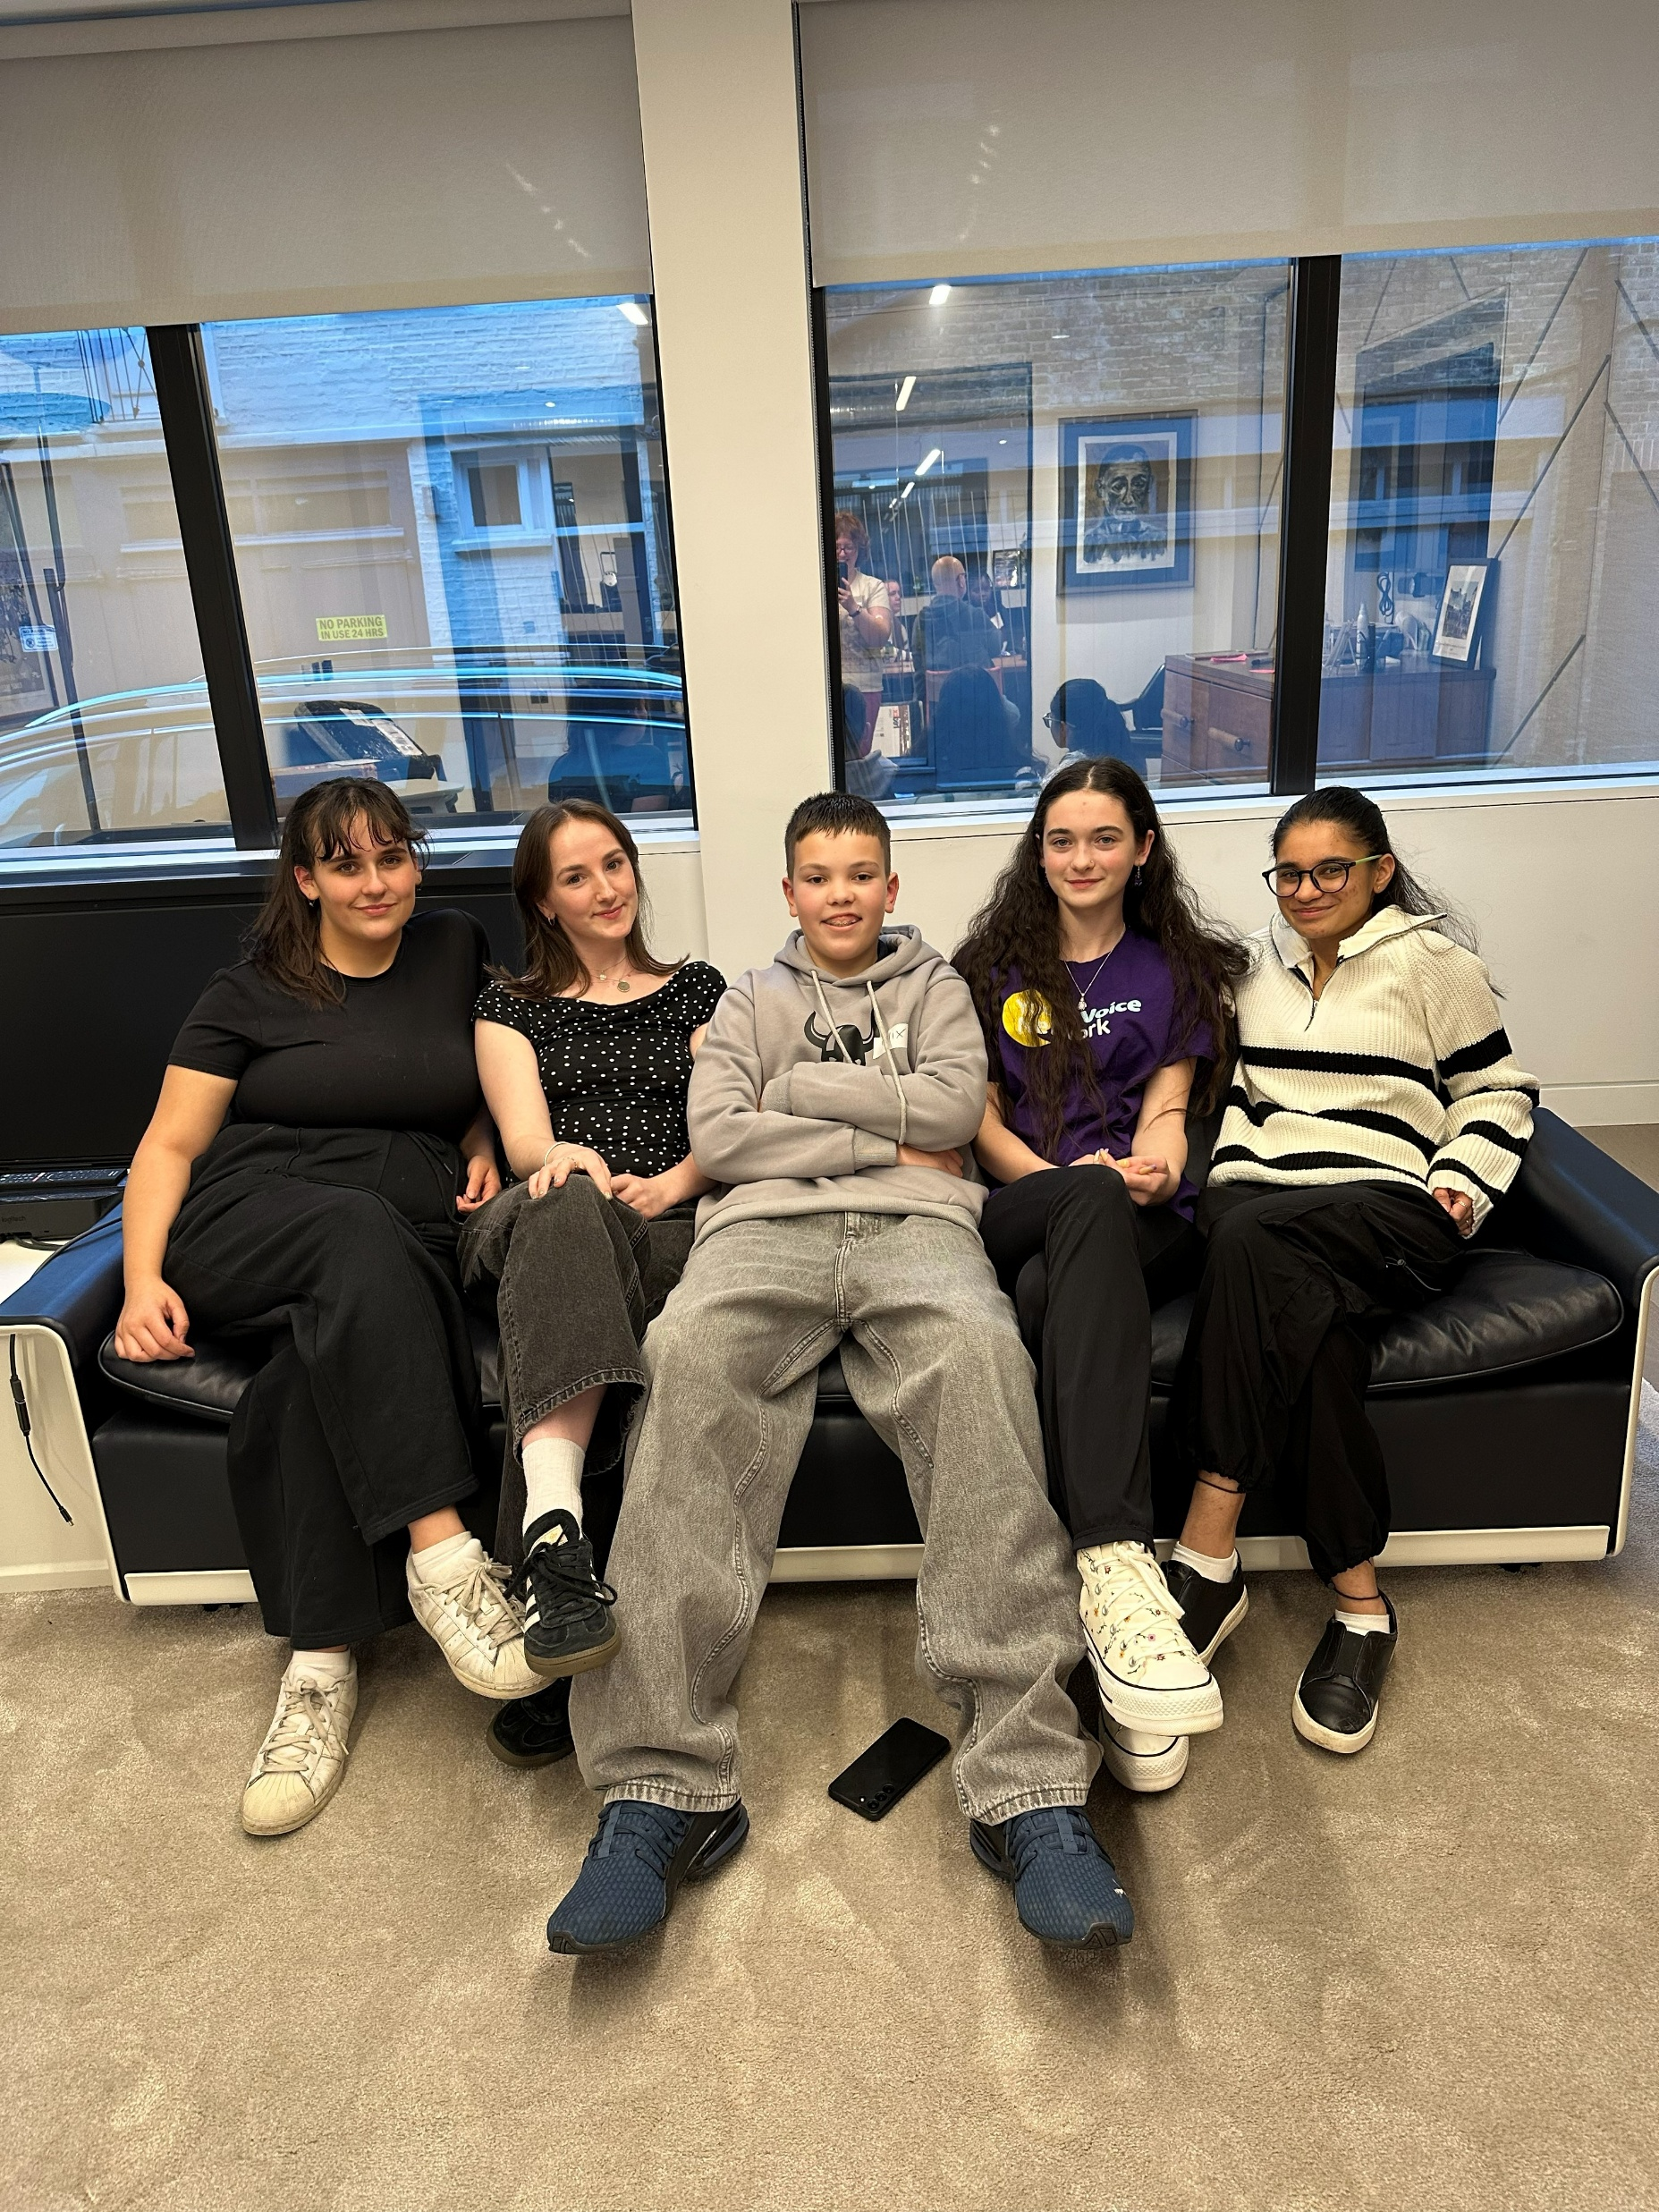
Community
Listening to and understanding the lived experiences of children and young people with epilepsy is at the core of how we work at Young Epilepsy.
Social Media
Share, learn and find support
Virtual Youth Clubs
Online games and activities, sharing experiences and making friends - 8-10, 11-15 and 16-18yrs
Meet-ups and Roadshows
Free events to meet others who get it!
Youth Voice Network (YVN)
Projects, research, influencing, fundraising and campaigns
Content Group and Editorial Panel
Young Trustees and Youth Council
283 attendances to our Virtual Youth Club in 2025
103 young people attended an in-person event in 2025
270+ YVN members in 2025
Notes:
We’re on TikTok, Instagram, Facebook and LinkedIn – a space for anyone living with or supporting a child or young person with epilepsy
Youth Clubs are the 2nd Monday of each month for those aged 8-18, split into 3 age groups
Meet-ups and Roadshow happen across the country, throughout the year – a safe space for CYPE and their families to meet others at different stages of their journey. A mix of fun activities, free time and hearing from members of the YVN
The YVN has over 285 members, aged 13-25, from across the UK – they’re a growing community who help shape our policies, campaigns, comms, research, products and services – as well as having a lot of fun along the way! Two members are Young Trustees, and we now have 10 Youth Council Members too (aged 8-25)

Slide 9
Improving health and wellbeing
Our research and innovation work is grounded in the lived experience of children, young people and families.

Slide 10
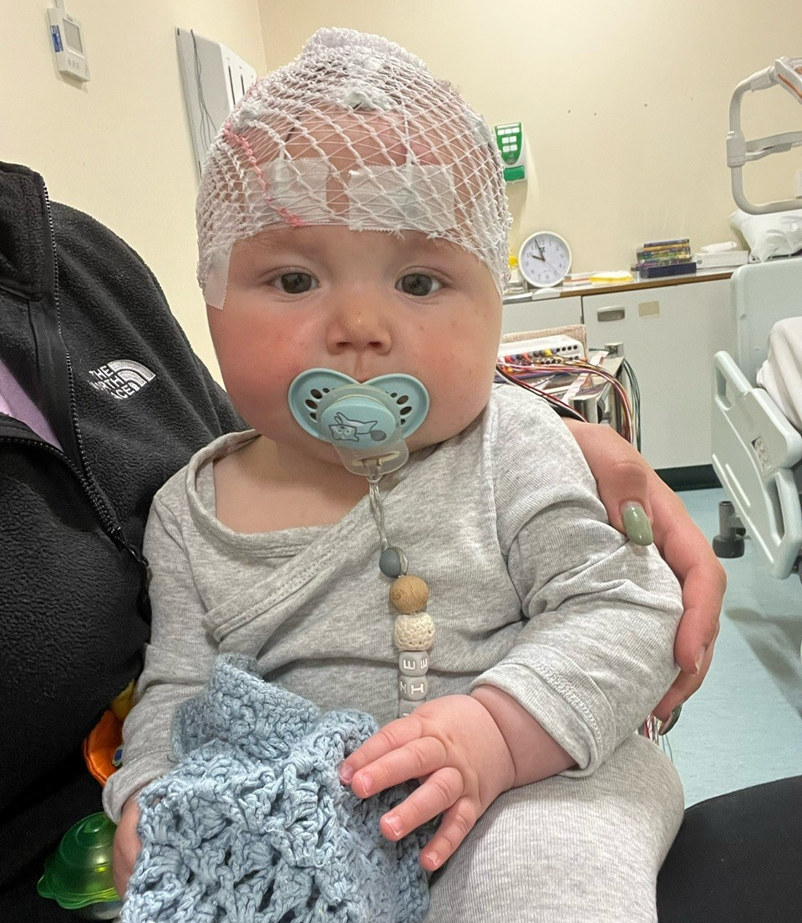
Research for children with epilepsy
Built for childhood, not adapted from adult research Focused on causes, development and real‑life impact
Driving earlier diagnosis and better treatments Helping get the right care, faster
Translating evidence into practice
Giving you insights and tools to support whole‑child care
Shaped by young people and families.
Their experiences directly influence what we research and how we apply it in practice.
What this means for you:
Earlier, more accurate diagnosis
Better-informed treatment decisions
Evidence you can trust to support whole‑child care

Slide 11
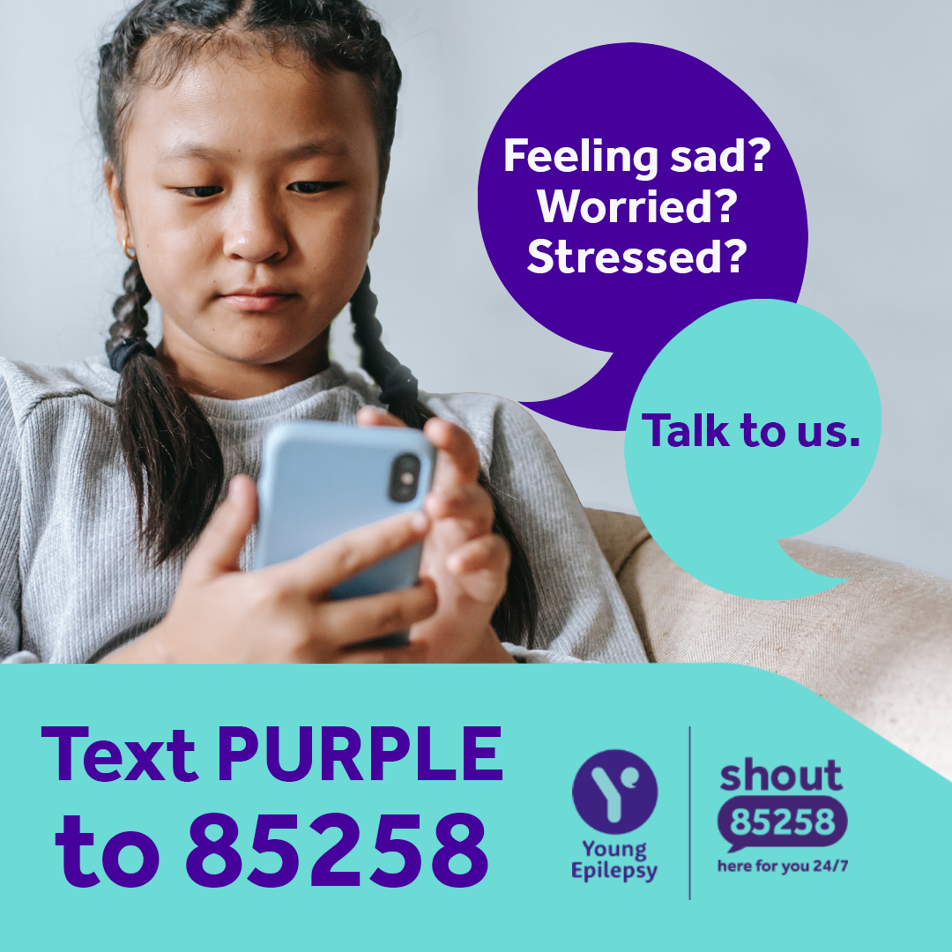

Increasing access to mental health support
Growing the evidence for integration
We’re working with NHS and academic partners to show how mental health support can be successfully integrated into epilepsy care.
24/7 support for young people
Shout – A free, confidential text support service for anyone who is struggling to cope.
Acceptance and Commitment Therapy (ACT) self-help resource **Coming soon**
MyMind – Build habits for better wellbeing
Notes:
Young people tell us that living with epilepsy has a big impact on their mental wellbeing, so we’re working to increase access to mental health support.
Through our research and innovation work we’re showing how mental health checks and support can be successfully integrated into epilepsy care.
We’re also providing direct help through our partnership with the ‘Shout’ text support service and a new self-help resource grounded in Acceptance and Commitment Therapy (ACT), developed specifically for young people with epilepsy.

Slide 12
Inclusive education opportunities
Helping education professionals to understand the impact of epilepsy on students – improving their knowledge and confidence, so inclusion is the norm.

Slide 13
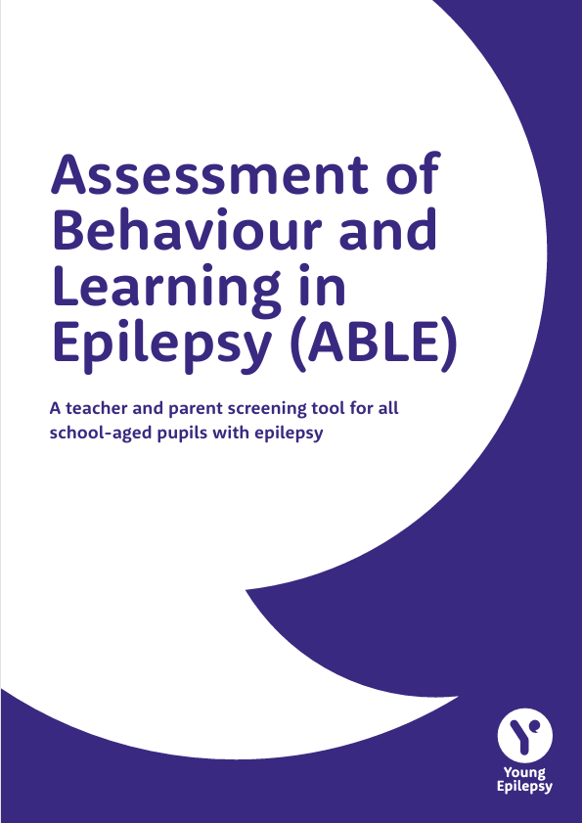
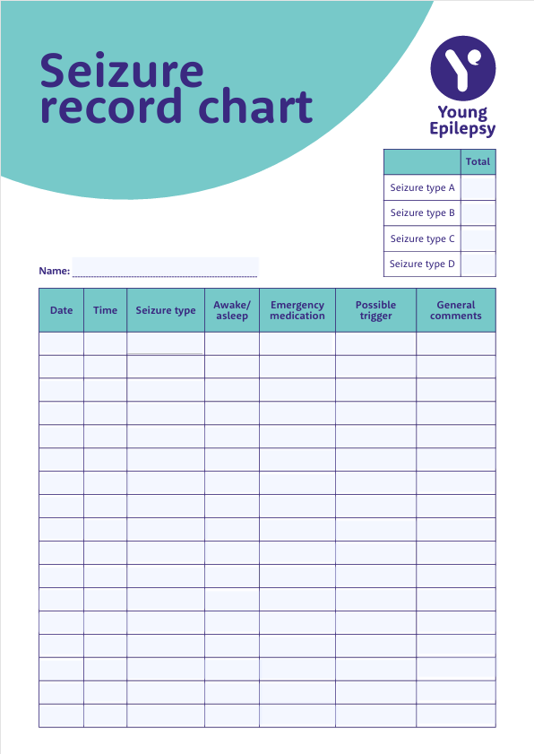
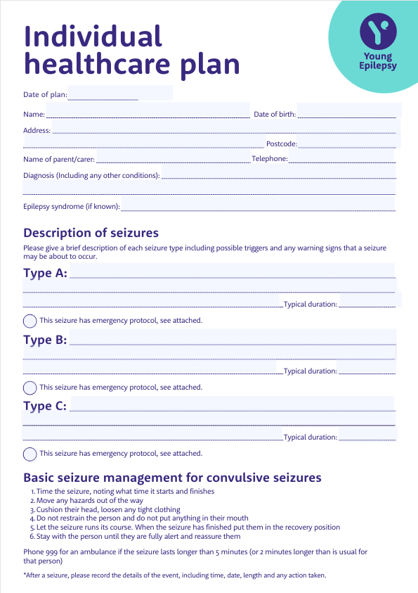
Tools, templates and training
We have a range of tools and templates to help educators ensure all children and young people with epilepsy are fully included in school:
Individual healthcare plan (IHP)
Assessment of Behaviour and Learning in Epilepsy (ABLE) tool
Seizure observation and treatment form
Seizure record chart
We also have a FREE eLearning and more in-depth Guide for Schools to help build confidence.
Check out the Education Professionals section of our website to access or signpost to these.
Notes:
Lots of information on our website, plus we have the free eLearning and downloadable templates - we have some physical inclusion packs we can provide healthcare professionals, families or schools directly too.
Developing even more resources (that work for educators!) is a key focus of our strategy over the next couple of years

Slide 14
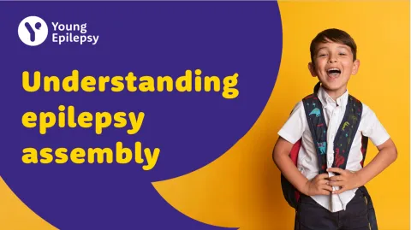


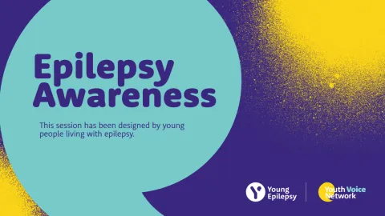
New classroom resources
Co-created with teachers earlier this year, we’ve just launched a suite of FREE resources for primary schools to use.
Understanding epilepsy assembly - including a presentation and script
KS1 lesson pack – including a lesson plan, presentation and activity sheets
KS2 lesson pack – including a lesson plan, presentation and activity sheets
Members of our Youth Voice Network have created a youth led secondary school assembly too.
These can all be found on the Classroom Resources page of our website.
Notes:
Please share these with your school contacts!
The book mentioned earlier is great for use in the classroom too.

Slide 15

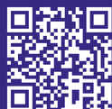




We help you
help them
Tools & resources for you. Information & support for them
Find out more
Youngepilepsy.org.uk

