Slide 1



Paediatric Advanced Practice Network (PAPn)
24-09-2025

Slide 2

Today’s meeting
S. Meenan and A. Righetti - Network update
Serotonin syndrome– Amy Clarkson, senior ACP at SaTH
Head Injury - Dr Kumar, PEM consultant at Leicester Children’s Hospital
AOB

Slide 3

PAPn CONFERENCE 2026
SAVE THE DATE – 27/3/2026
Face to Face
Great Ormond Street Hospital

Slide 4
CALL FOR ABSTRACTS
PROGRAMME
TBC
Lectures
Workshops
AP showcase
Tickets on sale soon

Slide 5
CALL FOR ABSTRACTS – NOW OPEN!
Max 300 words (excluding references)
Highest scoring abstracts will be selected for oral presentations
Any topics across the 4 pillars of advanced practice in paediatrics are welcomed
Abstracts must include: title, background, aim, method, results and conclusion
Send your abstract to: bchnt.partnersinpaediatrics@nhs.net
Deadline for submission – 02/1/2026
Abstracts outcome – end of January 2026

Slide 6
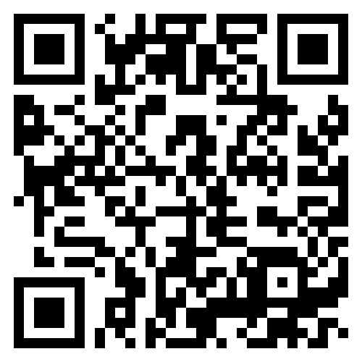
Looking to share your knowledge or projects?

Slide 7

SAVE THE DATE
Next PAPn meeting online 1-2.30pm- 19/11/2025
PAPn Conference – 27/3/2026

Slide 8
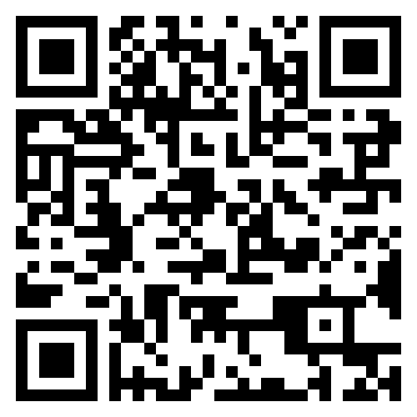
Feedback

Slide 9



Contact us at:
bchnt.partnersinpaediatrics@nhs.net

