Slide 1



Paediatric Advanced Practice Network (PAPn)
28-01-2025

Slide 2

Today’s meeting
S. Meenan and A. Righetti - Network update
Cardiac, Pre Itu Management & Overview of Cardiac Anomalies in Paediatrics - Cho Ng, Paediatric Cardiac Intensivist Great Ormond Street Hospital
Leadership Academy Opportunities for Advanced Practitioners - Corinna Thomas, Strategic Lead for Standards & Frameworks Leadership and Management centre of Excellence, NHS England
AOB

Slide 3
PAPn Conference - 28/3/2025
Alder Hey Hospital – Liverpool
https://www.eventbrite.co.uk/e/paediatric-advanced-practice-network-study-day-tickets-1088463707249?aff=oddtdtcreator
40£ PIP members
55£ General Admission
Abstract Outcome – Beginning of February

Slide 4

Syncope
Paediatric Asthma
Paediatric and child health advanced practice area specific capability and curriculum Framework
The Unwell returning traveller
Antimicrobial stewardship
Advanced Practice Showcase
Workshops
……………..HOPE TO SEE YOU THERE!

Slide 5
Paediatric and child health advanced practice area specific capability and curriculum Framework - now published
“We are delighted to share that the Centre for Advancing Practice has published their endorsed Paediatric and Child Health Advanced Practice Capability and Curriculum Framework! The framework was created to support the supervised and structured training for advanced practice roles working with infants, children and young people, and was developed in collaboration with the RCPCH. Access the framework here: https://advanced-practice.hee.nhs.uk/our-work/credentials/endorsed-credentials/ and watch this space for more support resources coming”. The Paediatric and Child Health Advanced Practice Framework Writing Group.

Slide 6

SAVE THE DATE
Annual Face to face study day – 28th March 2025
Next PAPn meeting online 1-2.30pm- 28/5/2025

Slide 7
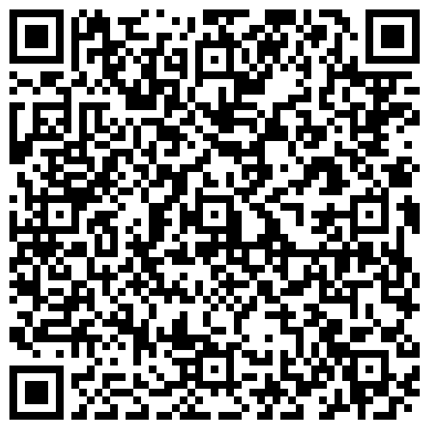
Feedback

Slide 8



Contact us at:
bchnt.partnersinpaediatrics@nhs.net

