Slide 1

Upcoming Continuous Professional Opportunities
PEN-SO

Slide 2
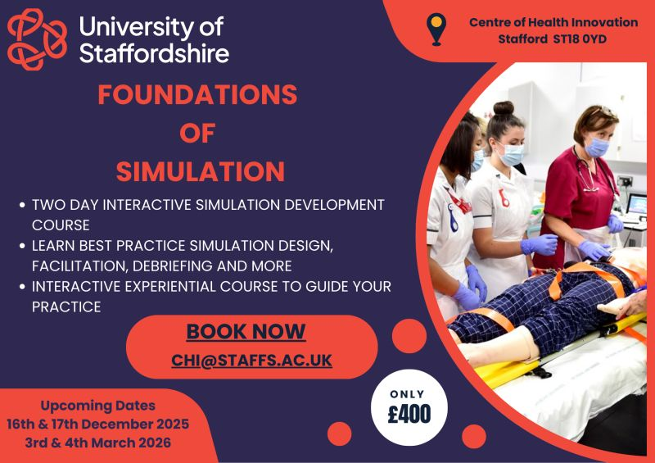

Slide 3

CPD Course Links University of Staffordshire
Simulation for Assessment: https://www.staffs.ac.uk/course/simulation-for-assessment-course
Debriefing Simulation Practice Effectively: https://www.staffs.ac.uk/course/debriefing-effectively-course
Health, Science & Wellbeing – CPD and Micro- credential courses: https://www.staffs.ac.uk/courses/short/health-science-and-wellbeing

Slide 4
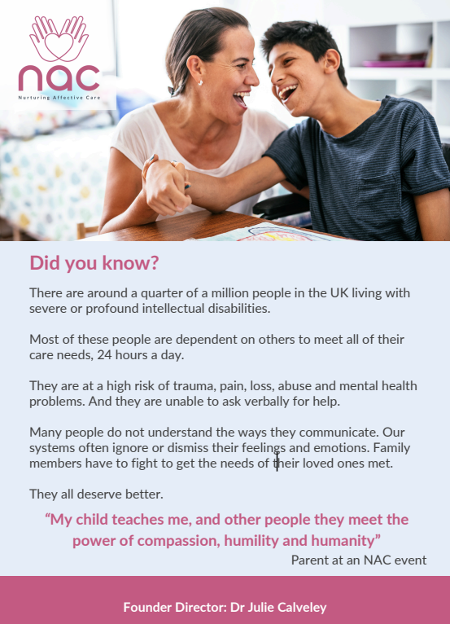
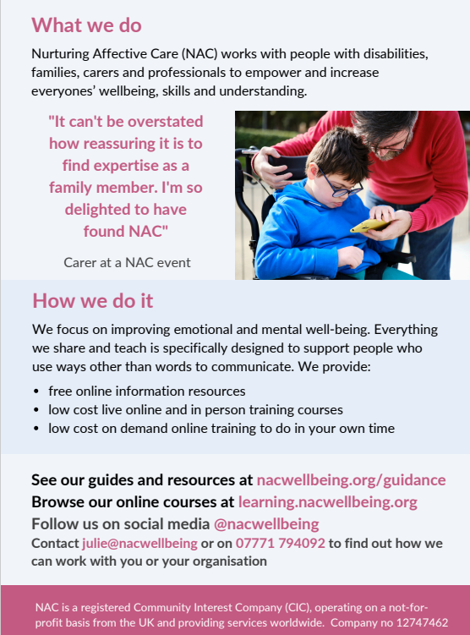

Slide 5
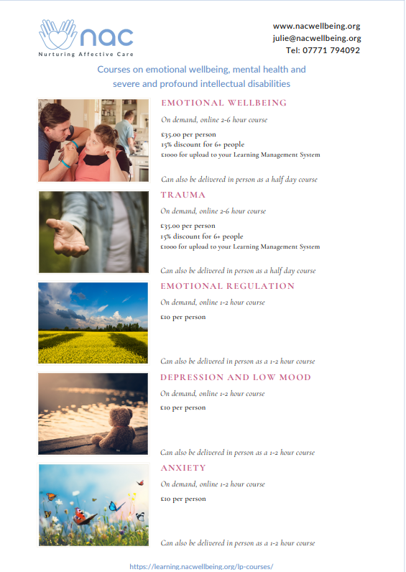

Slide 6

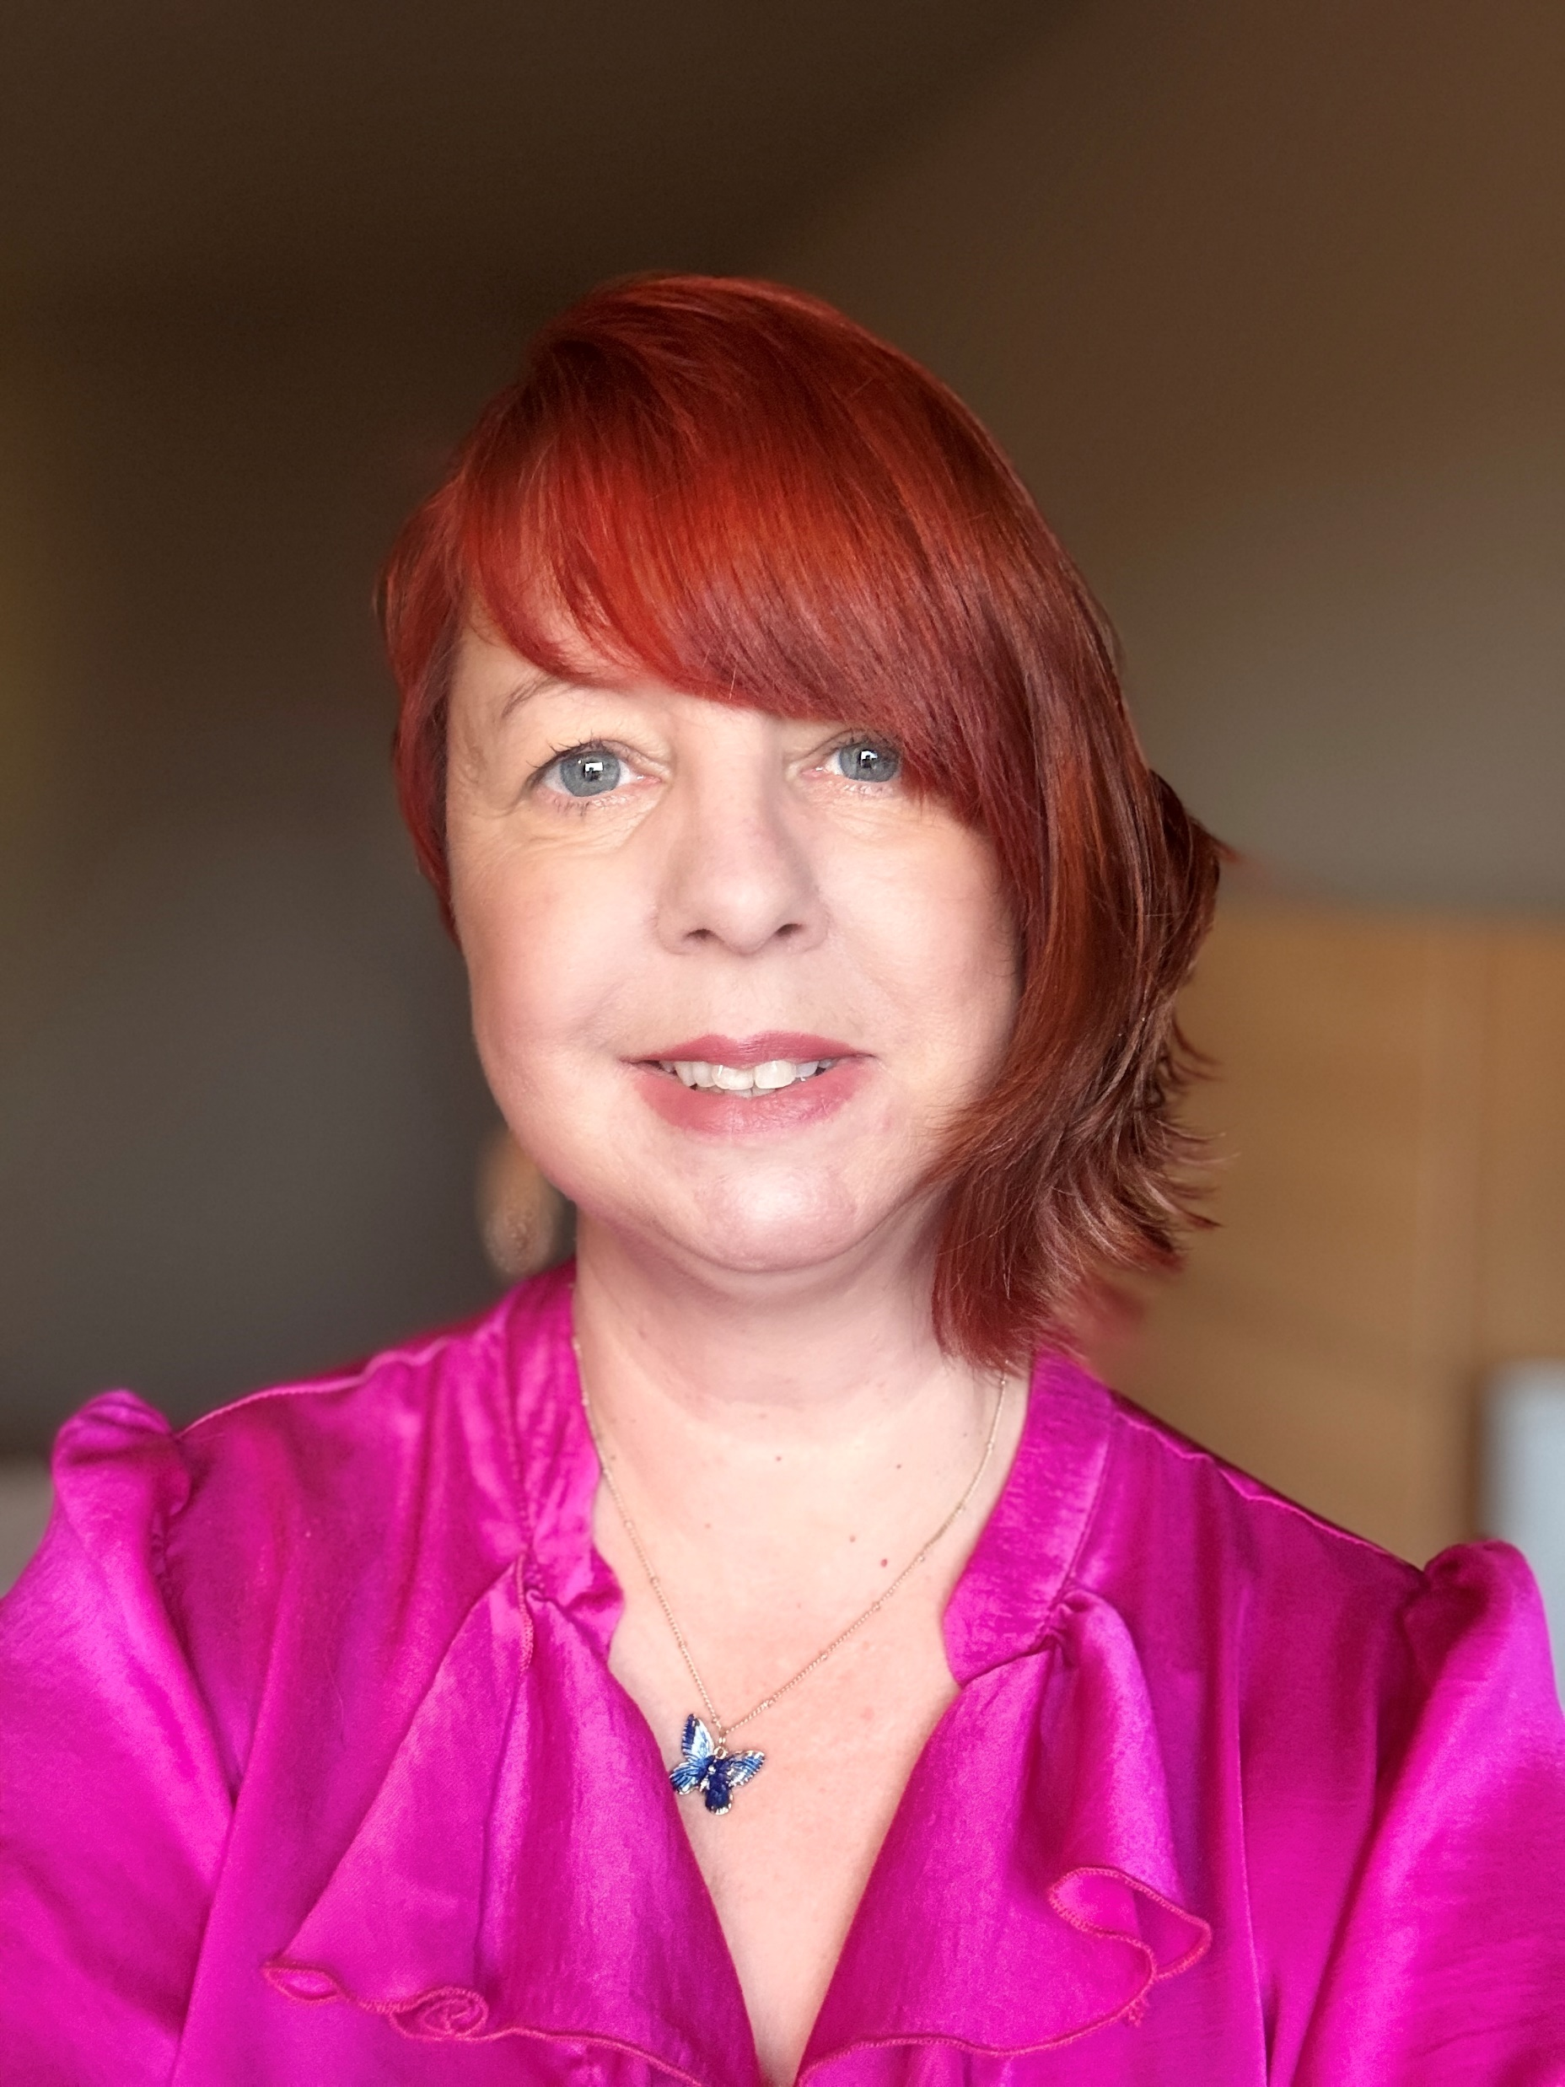
I’m running a practical, results-focused masterclass on Monday 6 October at 12pm called Confidence, Clarity, Courage, designed to help people rebuild self-worth, shift self-doubt, and strengthen their confidence at work and home.
Because wellbeing is a business priority right now, I’m offering organisations a single corporate access option: £99 for as many employees as you’d like to join the live session and receive lifetime access to the replay. It’s an affordable, high-impact way to support staff resilience, reduce presenteeism, and give people tools to perform under pressure.
What’s included:
60-minute live masterclass (practical, evidence-based tools)
Lifetime access to the recorded replay for all staff who register
Live Q&A immediately after the session (only available to live attendees)
A promo code I’ll create so your team can register and bypass payment
If you’d like to take this up, I’ll set up a bespoke promo code for your organisation and share the registration link for your team to use. Just reply with the name of your organisation and the contact email you’d like me to send the code to, no headcount needed up front.
Sarah Wilson
UK Top 5 Transformational Mindset Coach
Rebuild your identity, self worth and resilience repressed by toxic relationships
t: 07714 472383
e: info@coastalcoachingsussex.co.uk
Linktree: https://linktr.ee/sarahwilsoncoach

Slide 7
"Essentials of Nursing Children." While we can't send physical copies, we can provide full access to a free chapter on the book’s webpage for your attendees to preview.
Sage Publishing – Free Book Gift Access Online!
Hi Everyone – Please Enjoy the link to the actual PDF, or better to have people visit the home page https://uk.sagepub.com/sites/default/files/upm-assets/140702_book_item_140702.pdf
https://uk.sagepub.com/en-gb/eur/essentials-of-nursing-children-and-young-people/book268860#preview
Sarah Silvester (She/Her)
Academic Sales Consultant | Midlands and East Anglia
Textbook Division – Faculty Resources
SarahJane.Silvester@sagepub.co.uk

Slide 8
The lecturers can also request a free print copy. Here is the easiest form that will not require them to register first Request inspection copies Survey https://uk.surveymonkey.com/r/inspection-copies?Campaign=%5BICs%5D
We can also offer 30% discount code to all the other participants who are not the lecturers - UK30BOOKS
This is our conference’s discount, so it is appropriate. This discount is valid on our website and ebooks.com. it will be free P+P in the UK.
Hope they will find this helpful.
Best wishes,
Sarah
Sarah Silvester (She/Her)
Academic Sales Consultant | Midlands and East Anglia
Textbook Division – Faculty Resources

Slide 9
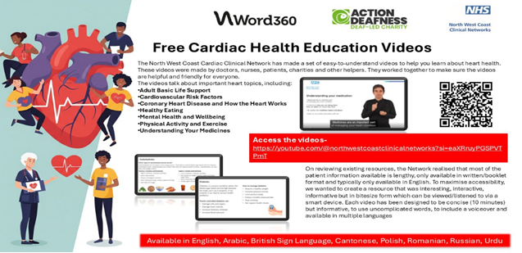

Slide 10
The NorthWest Coast Clinical Network are excited to launch a pioneering series of FREE cardiac health information videos that transforms how heart patients obtain vital guidance, with a particular focus on addressing longstanding health inequalities in accessing cardiovascular care.
The free to access videos can be accessed here https://www.youtube.com/@northwestcoastclinicalnetworks.
We have also produced promotional materials (also available in other languages) which can be used to communicate this resource with patients https://www.england.nhs.uk/north-west/north-west-coast-strategic-clinical-networks/our-networks/cardiac/cardiac-patient-health-videos/
Videos are available covering the following topics:
• Adult Basic Life Support
• Cardiovascular risk factors
• Coronary heart disease and how the heart works
• Healthy eating
• Mental health and wellbeing
• Physical Activity and exercise
• Understanding your medicines
All videos are also available in the following languages:
• Arabic
• Cantonese
• Polish
• Romanian
• Russian
• Urdu
• British Sign Language.
This groundbreaking initiative directly tackles research findings that show patients for whom English is not their first language have been poorly served by existing cardiac care resources, contributing to significant health inequalities. Following extensive analysis of current provision, the clinical network team identified a critical gap where most materials existed only in written English. Each video has been co-produced with representatives from the relevant cultural and deaf communities and underwent a rigorous verification process through accredited translation organisation Word 360 and charity Action Deafness. The videos also standardise and streamline cardiac education ensuring accessibility for patients with reading difficulties through voiceovers and easy-read language
Please support the spread and adoption of this fantastic FREE resource by sharing this email across your wider networks!!

