Slide 1


Partners in Paediatrics
Annual General Meeting
2026
Notes:
---

Slide 2
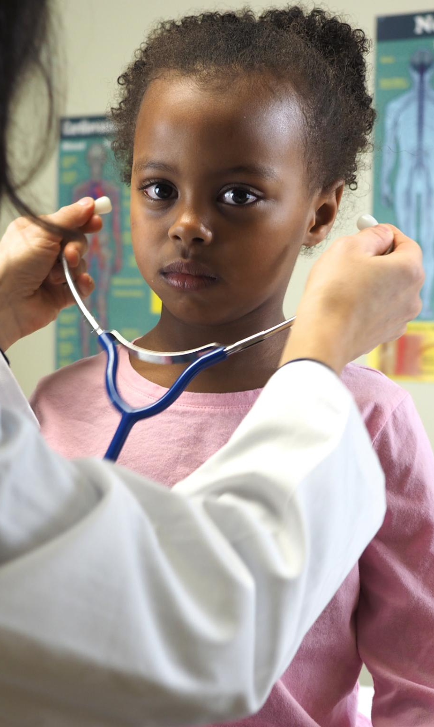
About Us
Established in 1997, PiP is a collaborative partnership dedicated to improving health services for children and young people across the West Midlands.
Key Highlights
29 years of supporting and improving paediatric services.
Strong partnerships with NHS, third sector, and regional stakeholders.
Supports:
  10 Reginal Clinical Networks and Education Forums
  4 National Networks
  1 International Collaboration
Drives service improvement, clinical guideline standardisation, and high-quality patient-centred care.
Coordinated by a small core team and delivered through the expertise of member organisations.
Notes:
Partners in Paediatrics (PiP) is a long-established collaborative partnership formed in 1997 with the purpose of improving the quality, accessibility, and equity of healthcare services for children and young people. Operating across the West Midlands and the areas served by its member organisations, PiP brings together NHS trusts, integrated care boards, and partner organisations to work collectively on shared paediatric priorities. Over nearly three decades, PiP has developed strong and trusted relationships with NHS partners, third sector organisations, and regional stakeholders, positioning itself as a respected advocate for children’s health services. A key strength of PiP lies in its network-based approach, supporting 14 paediatric clinical networks, including three national networks, which span a wide range of specialties and professional groups. These networks enable clinicians and system leaders to share expertise, develop consistent standards of care, and address unwarranted variation across the region. The work of PiP is coordinated by a small core team, but its impact is driven by the commitment, leadership, and collective expertise of its members. This slide provides audiences with a clear understanding of who PiP is, its regional role, and its enduring commitment to collaboration as the foundation for improving outcomes for children, young people, and their families.

Slide 3


Looking Ahead
Continue to strengthen collaboration and paediatric networks across the region.
Ensure children, young people, and families remain at the centre of all our work.
Provide a strong regional voice across health, social care, and third sector systems.

Slide 4

Strategic Priorities and Progress:
Focus on Paediatric Excellence
Strategic Objective:
Build robust and sustainable paediatric clinical networks that improve equity, quality, and continuity of care.
Key Actions and Progress:
Supported the establishment and maturation of paediatric clinical networks across specialties and geographies, with representation from tertiary, secondary, community, and primary care settings.
Clarified governance arrangements within networks, including defined roles, accountability, and decision-making processes.
Enabled multidisciplinary collaboration through regular network meetings, shared digital platforms, and agreed standards for communication and data sharing.
Aligned network activity with key system workstreams, including workforce planning, digital transformation, quality improvement, research, and population health.
Promoted system-wide models of care that support delivery closer to home while maintaining access to specialist expertise.
Impact:
Improved coordination across paediatric services.
Reduced duplication of activity and clearer referral pathways.
More consistent outcomes and experiences for children and young people.
Notes:
This slide introduces the strategic priorities that have guided Partners in Paediatrics during the 2025–2026 reporting period. The overarching focus has been on strengthening paediatric clinical excellence through system-wide collaboration, improved links with evidence-based commissioning, and the delivery of consistent, high-quality care. The slide sets the context for the more detailed sections that follow, explaining that PiP’s priorities are framed around clear strategic objectives, specific actions, and measurable impacts for children and young people. It highlights the importance of partnership working across organisational boundaries, recognising the increasing complexity of the NHS landscape and the need for coordinated approaches to service improvement. By providing an overview, this slide helps the audience understand how individual initiatives and workstreams align with PiP’s broader mission and strategic direction.

Slide 5
GUIDELINES KEY aCTIONS AND progress
PiP & the Bedside Clinical Partnership have led the development, review, and dissemination of evidence-based paediatric clinical guidelines aligned with national standards and emerging research.
Ensured guidelines were co-produced with clinicians across care settings and, where appropriate, informed by service user perspectives.
Improved digital accessibility of guidelines and pathways to support real-time clinical decision-making.
Established review and audit mechanisms to ensure guidance remains current and effective.
Impact:
Reduced unwarranted variation in clinical practice.
Improved patient safety and reliability of care.
Clearer and more consistent care journeys for children and families.

Slide 6

Networks PiP Support
Regional Networks​
West Midlands Paediatric Anaesthetic Network ​
Paediatric Anaesthetic Trainee Network ​
Paediatric Epilepsy Nurses Network ​
Midlands Children's Long Term Ventilation Network​
Paediatric Senior Nurses Forum​
West Midlands Child Death Review Network​
West Midlands Child Protection Special Interest Group ​
National Networks:
Association of Child Death Review Professionals​
Paediatric Educators Network- Supporting Opportunities ​
Paediatric Advanced Practice Network​
Paediatric Liver AHP and Nurse Network
International Groups
International Society for the ​Study and Prevention of Perinatal and​ Infant Death (IPSID)
Education Forums:
West Midlands Neurology Forum​
Neurodisabilty Network West Midlands ​
West Midlands Children in Care Forum
Future Networks:
Paediatric Community Nursing Network
West Midlands Paediatric Infection Network

Slide 7
PiP Education
Annual Conference and AGM
  PiP organises an Annual Conference and AGM to bring professionals together for knowledge exchange and networking.
  Ongoing Education Forums
  PiP hosts ongoing education forums across nursing, paediatrics, neurology, and other specialties to support continuous learning.
  Commitment to Professional Development
  PiP’s efforts emphasise professional development and knowledge sharing as essential to delivering high-quality care.
2026
Tuesday 19th May – Looked After Children (LAC) Study Day
Friday 22nd May - Paediatric Anaesthetic Network (PAN) Annual Conference
Dates for Diary 2027​
Friday 12th March – Paediatric Advanced Practice Network (PAPn) Conference
Friday 26th June – Paediatric Epilepsy Nurses Network (PENN) Conference
Friday 3rd July - Midlands Paediatric Complex Epilepsy and Epilepsy Surgery Study Day
Wednesday 24th June - West Midlands Child Death Review Network (CDRN) Study Day
Thursday 1st October – Paediatric Educators Network – Supporting Opportunities (PENSO)
Tuesday 13th October – Partners in Paediatrics Annual Conference & AGM​
Tuesday 3rd & Wednesday 4th November – Association of Child Death Review Professionals (ACDRP) Annual Conference
Monday 5th October – Paediatric Liver AHP & Nurse Network (PLANN) Study Day
Wednesday 9th July – Network Leadership Day – Developing Our Leaders
Friday 27th November – Neurodisability Network West Midlands (NNWM) Conference​
Friday 19th March – Paediatric Anaesthetic Network (PAN) Annual Conference
Friday 18th June – Paediatric Epilepsy Nurse Network (PENN) Annual Conference
Notes:
This slide highlights PiP’s role in delivering conferences, education forums, and learning opportunities. It references the Annual Conference and AGM, as well as ongoing education forums across nursing, general paediatrics, neurology, and other specialties. The slide reinforces PiP’s commitment to professional development and knowledge sharing as key enablers of high-quality care.

Slide 8
Finance 25-26
Overview |  |  |  | Closing balance (cleared only)
 |  |  | PiP Income | £ 35,689.60
Balance |  |  | Guideline Books | £ 1,061.90
Opening balance | £ 167,999.98 |  | Looked After Children | £ 2,842.07
25-26 Subscription Income | £ 105,000.00 |  | Cerebral Palsy and Spasticity | £ 513.03
Pay Costs | £ 134,614.89 |  | WM Paediatric Anaesthetic | £ 16,147.65
Closing balance | £ 76,539.91 |  | Paediatric Epilepsy Nurses | £ 1,516.00
 |  |  | WM Child Death Overview Panel | £ 765.41
 |  |  | Long Term Ventilated Network | £ -
 |  |  | Neurology Forum | £ 1,479.75
 |  |  | Paediatric Senior Nurse Forum | -£ 945.90
 |  |  | Project Support BCH | £ 12,313.79
 |  |  | PAPN | £ 3,837.48
 |  |  | PENSO | £ 1,319.13
 |  |  | Balance | £ 76,539.91
Notes:
The Finances slide provides space for high-level financial information or commentary. In the summary presentation, detailed financial data is not included, and the slide may remain minimal, ensuring transparency while maintaining focus on strategic themes.

Slide 9
The FUTURE
Continues to develop the guidelines App:
  KIDS/NTS
  Community Guidelines
  Patient Information
Support additional networks:
Infection Diseases
Community Network
Additional training and education:
Peer Review for paediatrics
Clinical Holding
Clinical Webinars

Slide 10

Members directory
NHS Birmingham and Solihull Integrated Care Board
Birmingham Community Healthcare NHS Foundation Trust
Birmingham Women’s and Children’s NHS Foundation Trust
Coventry & Warwickshire Partnership NHS Trust
Dudley Group NHS Foundation Trust
East Cheshire NHS Trust
George Eliot Hospital NHS Trust
Midlands Partnership NHS Foundation Trust
Robert Jones and Agnes Hunt Orthopaedic Hospital NHS Foundation Trust
Sandwell and West Birmingham Hospitals NHS Trust
Shropshire Community Health NHS Trust
South Warwickshire NHS Foundation Trust
The Royal Orthopaedic Hospital NHS Foundation Trust
The Royal Wolverhampton NHS Trust
The Shrewsbury and Telford Hospital NHS Trust
University Hospitals Birmingham NHS Foundation Trust
University Hospitals Coventry and Warwickshire NHS Trust
University Hospitals of North Midlands NHS Trust
Walsall Healthcare NHS Trust
Worcestershire Acute Hospitals NHS Trust
Herefordshire and Worcestershire Health and Care NHS Trust
Wye Valley NHS Trust

Slide 11

Partners in Paediatrics
Poem by Dr Anjum Gandhi
PiP, unique, unparalleled an example of pristine high-level collaboration
Bringing diverse teams together, breaking barriers and separation
Delivering training and learning events, providing exceptional education
Supporting over a dozen networks, a feat achieved with hard work, commitment and preparation
Numerous achievements but regional paediatric guidelines undoubtedly the best creation
Well attended conferences a marker of continuous success, fills our heart with elation
No challenge insurmountable, every task accepted without the slightest hesitation
Our motto to promote best practice and improve paediatric outcomes with focus and dedication
Sharing, learning, making children’s world happy and healthy, our destination

Slide 12
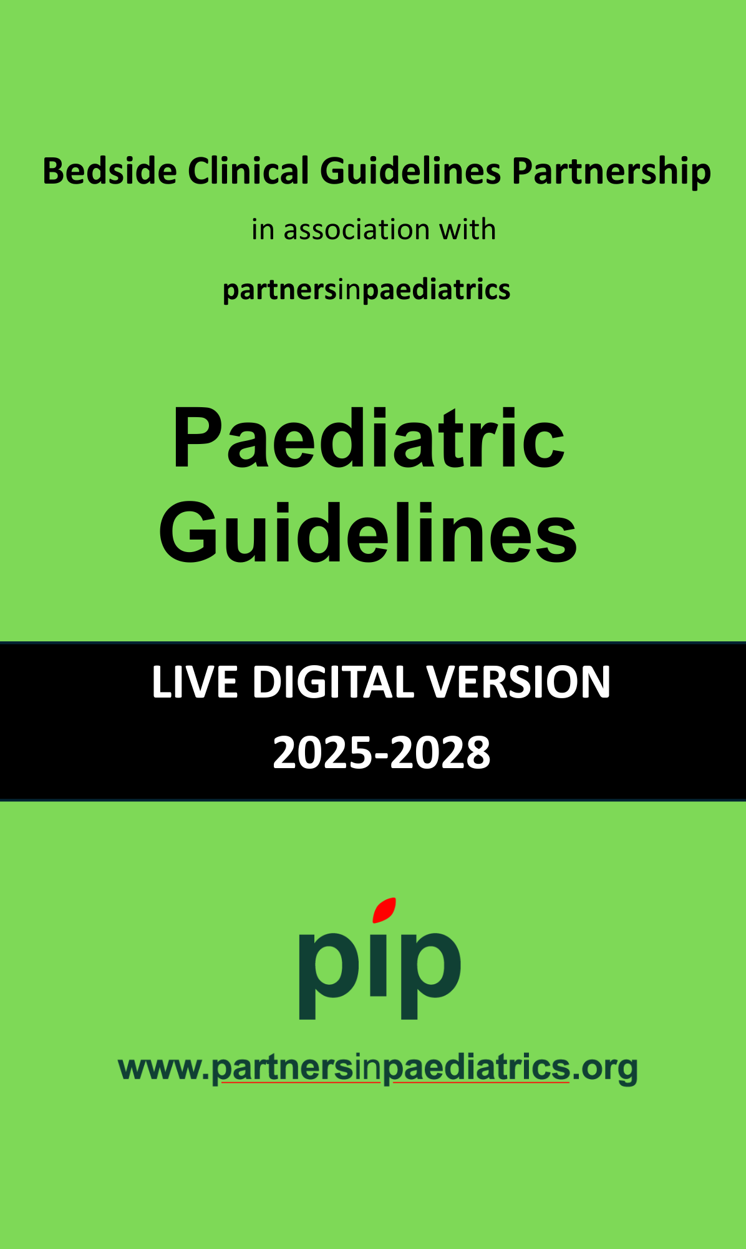
Guideline Pathway & Innovation
Strategic Objective:
Drive consistency, safety, and excellence in paediatric care through high-quality clinical guidance and clear care pathways.
Comprehensive Paediatric Clinical Reference App:
This resource provides comprehensive coverage of paediatric care, including acute and emergency management, neonatal care, chronic paediatric conditions, infectious diseases, and developmental disorders. It is grounded in evidence-based guidelines, reflecting current standards and best practices in paediatric medicine.
The App is designed for practical bedside use, the content is organised with clear bullet points, tables, and clinical algorithms to support rapid decision-making in wards, clinics, and emergency settings. Dedicated sections on critical care and resuscitation offer guidance for life-threatening situations, intensive care management, and emergency procedures.
An updated medication formulary with weight-based paediatric dosing charts ensures safe and accurate prescribing. The guide supports a multidisciplinary healthcare team, including doctors, nurses, and allied health professionals involved in paediatric care.
The app's compact design makes it a reliable point-of-care reference that supports safe, efficient clinical practice and improved patient outcomes.

Slide 13
Questions?

