Slide 1


PAEDIATRIC GUIDELINES APP

Slide 2
Presentation
Paediatric Clinical Guidelines Flowchart
What does the App look like?
Where can you find it?
How to access the App?
Future Developmentsnmation

Slide 3
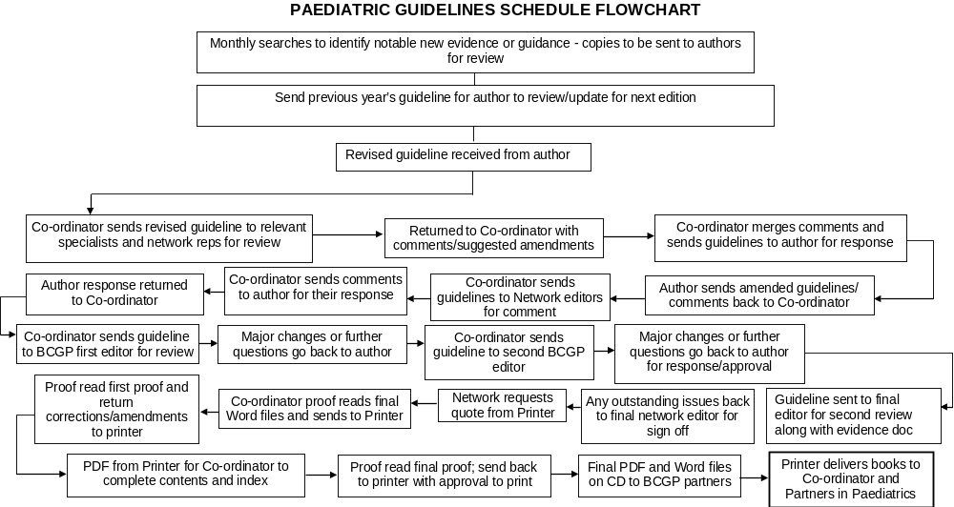

Slide 4
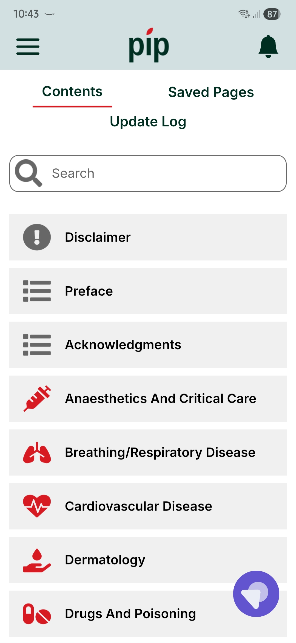
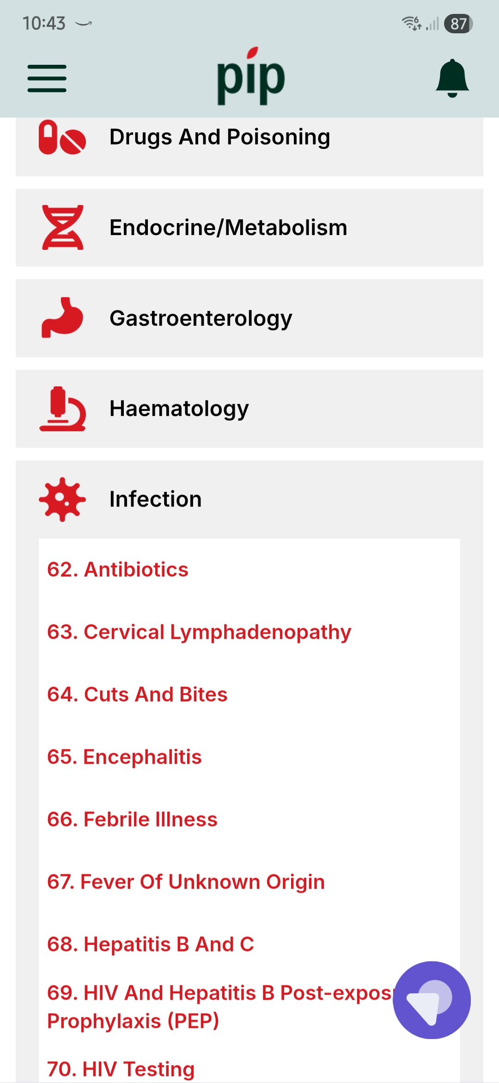
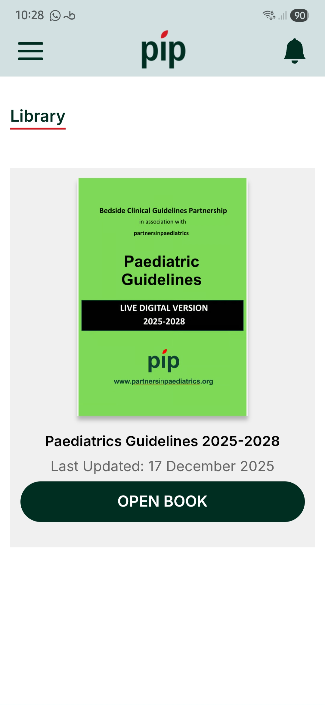
WHAT DOES THE APP LOOK LIKE?
Admin - Partners in Paediatrics
Notes:
Cardia

Slide 5
Where can you find the App?
On IOS and Play store
Through our Website (links to App stores)
NOTE: There is only one version of the App

Slide 6
THINGS WE NEED FROM YOU
A NOMINATED TRUST LEAD – TO MANAGE DISTRIBUTION OF CODES
THE REQUEST ALL USERS USE THEIR PROFESSIONAL EMAIL ONLY WHEN REGISTERING
AN AGREEMENT TO REVIEW USERS WITH PIP AFTER 1 YEAR TO HIGHLIGHT LEAVERS
TRUST WIDE PROMOTION TO ENSURE ALL APPROPRIATE MEMBERS ARE AWARE OF THE APP AND THEIR ‘FREE’ ACCESS TO IT

Slide 7
FUTURE DEVELOPMENTS:
Continue to add to the current Guidelines
  KIDS/NTS
  Breast Lump in children
2nd book on Community Guidelines
The App is live and will be continually updated
Guidelines leads are encouraged to support the development and review of current guidelines
PiP - Can provide an audit trail of who is assessing the App
Reinvest any profits made to enhance the App

Slide 8
22-Member organisations
NHS Birmingham and Solihull Integrated Care Board
Birmingham Community Healthcare NHS Foundation Trust
Birmingham Women’s and Children’s NHS Foundation Trust
Coventry & Warwick Partnership Trust
Dudley Group NHS Foundation Trust
East Cheshire NHS Trust
George Eliot Hospital NHS Trust
Midlands Partnership NHS Foundation Trust
Robert Jones and Agnes Hunt Orthopaedic Hospital NHS Foundation Trust
Sandwell and West Birmingham Hospitals NHS Trust
Shropshire Community Health NHS Trust
South Warwickshire NHS Foundation Trust
The Royal Orthopaedic Hospital NHS Foundation Trust
The Royal Wolverhampton NHS Trust
The Shrewsbury and Telford Hospital NHS Trust
University Hospitals Birmingham NHS Foundation Trust
University Hospitals Coventry and Warwickshire NHS Trust
University Hospitals of North Midlands NHS Trust
Walsall Healthcare NHS Trust
Worcestershire Acute Hospitals NHS Trust
Herefordshire and Worcestershire Health and Care NHS Trust
Wye Valley NHS Trust

