Slide 1
Working together to make lives better for children.
Dr Aditi Gupte – GP and Clinical cancer lead BBCS ICB
Ann Marie Wright- Commissioning Manager Cancer and Diagnostics BBCS ICB

Slide 2
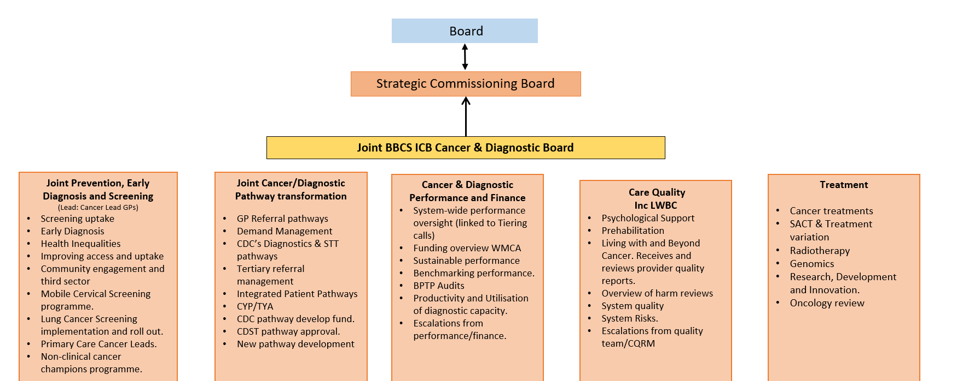
How we collaborate
Digital integration and connectivity/Workforce

Slide 3
How we collaborate
BIRMINGHAM COMMUNITY HEALTHCARE TRUST
BIRMINGHAM WOMEN’S AND CHILDREN’S HOSPITAL
ROYAL ORTHOPAEDIC HOSPITAL
UNIVERSITY HOSPITALS BIRMINGHAM
INTEGRATED CARE SYSTEM
PRIMARY CARE
NATIONAL & REGIONAL DIAGNOSTIC NETWORKS
INDEPENDENT SECTOR DIAGNOSTIC PROVISION
COMMUNITY DIAGNOSTIC SERVICES
DIGITAL TEAMS
SENIOR RESPONSIBLE OFFICERS
PROJECT MANAGERS
MEDICAL DIRECTORS
CLINICAL LEADS
OPERATIONAL LEADS
DATA ANALYSTS
ACCESS TEAM
DIGITAL INTEGRATION TEAMS

Slide 4
Breast lesions in Children - Introduction
Dept of Paed Oncology in receipt of several referrals each year of young patients with a ‘Breast Lesion’
3.2% of teenage girls in UK with breast lumps
10% of symptomatic referrals to breast clinics are adolescents under 18 years
Non-oncological issues
Generate significant anxiety
Lack of clarity for appropriate referral pathway & management approach
Interesting geographical variation across greater west midlands ICS’s
          Urgent Cancer Pathway inappropriate referral <> Confusion with ‘Adult’ urgent cancer pathways
>>>Great opportunity to collaborate with PiP to compose an agreed approach supporting primary and secondary care.

Slide 5
Breast lesions in children
✓
No malignant breast disease
identified in this cohort
What the evidence tells us
STUDY COHORT
WHY PATIENTS WERE REFERRED
102
adolescents referred
58
confirmed and included
Breast mass
66%
Size / symmetry
29%
aged 11–18
56.9% of referrals
Infection
5%
Among patients with a breast mass
Management was mainly conservative
76%
18%
Key diagnoses
1
2
3
Clinical review
Imaging
Surgery
reported in the study
assessment
surveillance
29% of mass cases
Fibroadenoma
Fibrocystic pathology
Clinical message
Most presentations were benign; pathways should prioritise proportionate assessment, reassurance and surveillance.

Slide 6
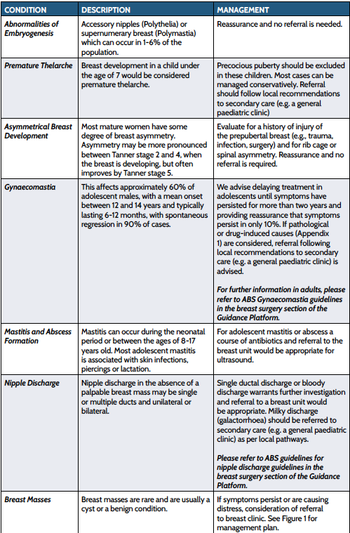
Breast lesions in Children - Background
Important consideration: pubertal status/age/gender/syndromal and other symptoms/medication
The local guideline relevant to patients < 16yrs
Recognition of the Urgent Cancer Referral pathways logistics

Slide 7
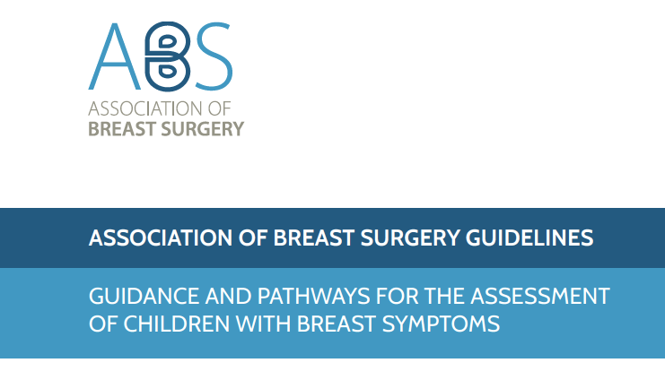
Breast lesions in Children - Background
Association of Breast Surgery (UK) developed guidelines to address such issues
We have incorporated elements of this guideline into our regional guideline.

Slide 8
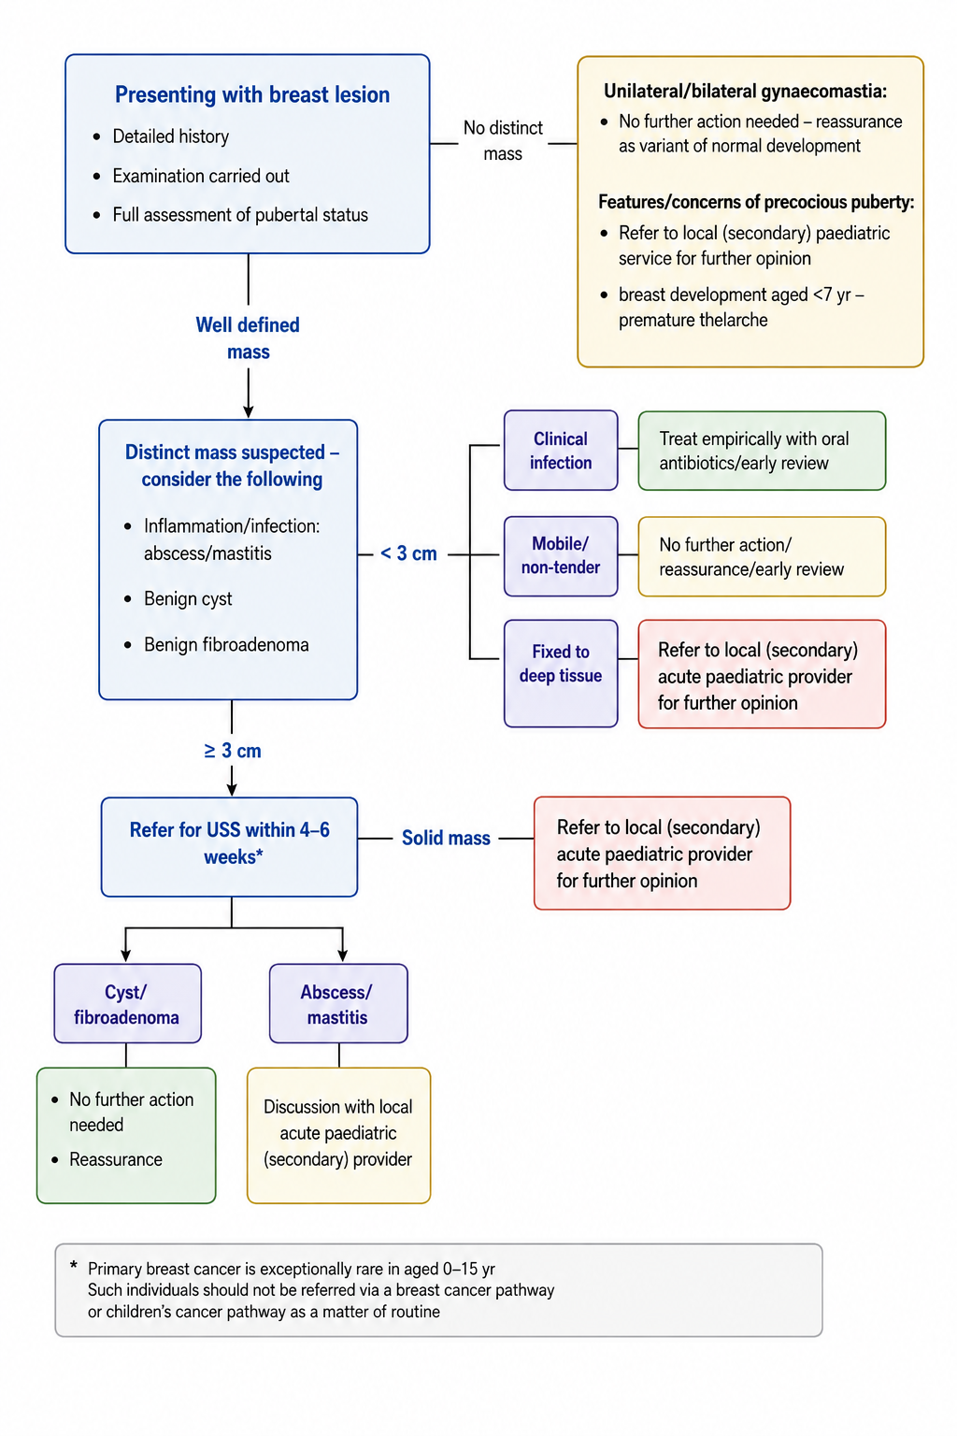
Breast lesions in Children – Outline of Guidance

Slide 9
Breast lesions in Children – Imaging recommendations
Dedicated specialist breast imaging not required for early assessment
Non-urgent USS is advised (4-6 weeks)
Recommendation to add the following to the imaging request form:
‘As per BSOL pathway - please DO NOT process as per symptomatic breast lump pathway as this is not appropriate in children’….
Provide as much clinical information as you can
Indicate the need to define if the lesion is ‘Solid’ or ‘Cystic’ in nature and determine and accurate size of the lesion

Slide 10
Key messages for primary care:
This pathway is designed for PRIMARY CARE, please follow the flow chart.
Paediatric breast lump referrals should be accepted by your local General Paediatrics for clinical review
Suspected malignancy concerns from PRIMARY CARE
If a GP has an exceptional concern regarding malignancy, they should seek Advice and Guidance (A&G) from the adult breast service rather than submitting a 2- week-wait (urgent suspected cancer) referral.
There is agreement across the system that 2-week-wait breast referrals for patients aged under 16 years will no longer be accepted from 1 November 2026 by adult breast services at UHB (following a three month implementation period commencing 1 August 2026).
4. When wanting further advice for a paediatric breast lump please refer to the flow chart and if needed refer to your local general paediatrician on ERS or Advice and Guidance

Slide 11
Key messages for primary care:
5. The vast majority of paediatric breast lumps are benign and do not require urgent cancer assessment via phone or via 2WW urgent suspected cancer pathway.
6. You will no longer be asked by your local General Paediatric service to refer to adult breast cancer services as a 2-week-wait breast cancer referral as from 1st November 2026 primary care cannot refer to adult breast cancer services.
7. General Paediatricians will have an escalation route themselves to refer to UHB adult breast services if needed.

Slide 12
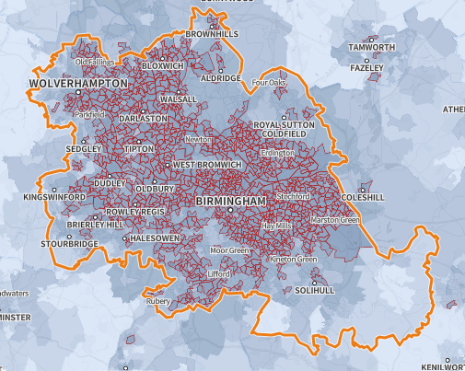
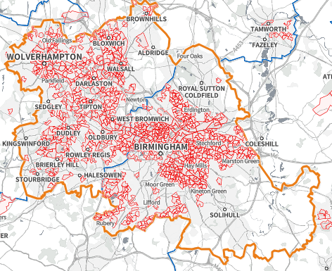
CYP Community Asthma service: Why?
Air Pollution Vulnerability Indicator
Core20 IMD

Slide 13






CYP Community Asthma service: Why?
01
Characterise the demographic and clinical profile of attending CYP
The case for community delivery
Assess asthma control using symptom scores and objective testing
02
Asthma is the commonest chronic respiratory disease in children and young people (CYP).
The 2024 BTS/NICE/SIGN guideline recommends objective testing — FeNO and spirometry — to diagnose asthma in those aged over 5.
NHS Community Diagnostic Centres (CDCs) can deliver this testing closer to home, consistent with the NHS 10 Year Plan.
We report 12-month outcomes of CYP referred from primary care and seen within two weeks.
03
Evaluate real-world adherence to the NICE diagnostic algorithm
04
Compare FeNO and spirometry by ICS adherence and symptom control
05
Determine the impact of clinic review on treatment and onward referrals

Slide 14
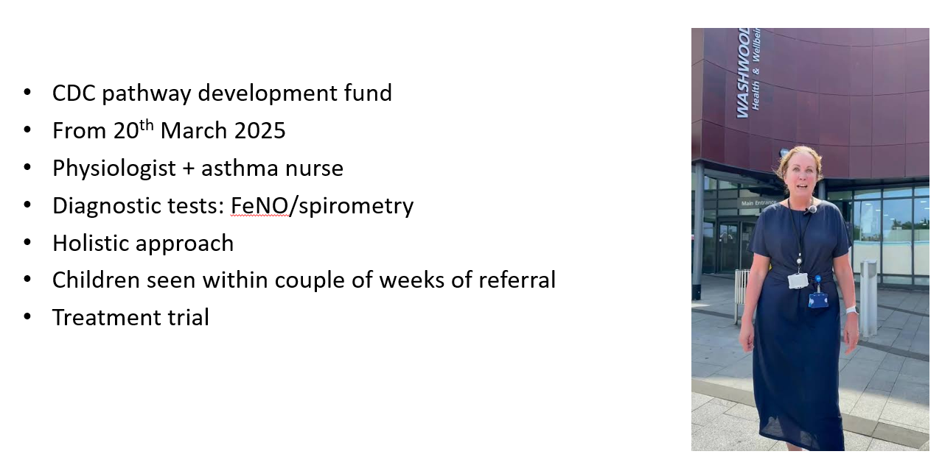
CYP Community Asthma service: Why?

Slide 15
CYP Asthma Service: Criteria
Aged 4-16 years with a suspected diagnosis of asthma
Aged 4-16 with a confirmed diagnosis of asthma
Any child or young person that have had a hospital admission for asthma within the last 4-6 weeks
2 or more emergency medical encounters for asthma exacerbation (ED, GP or walk-in)
2 or more courses or oral steroids within the last 12 months
3 or more SABA inhalers within the last 12 months
ICU or HDU admissions for asthma
Any child or young person who any health care professional is concerned about the asthma control

Slide 16









Blowing Away Inequality
219
children seen
A community asthma diagnostic hub for inner-city children & young people • Birmingham • 2025–26
WHAT THIS SERVICE DELIVERED
95%
81%
1 child
99%
seen within 2 weeks
of referral
given a clear asthma
diagnosis
only one child needed a
hospital referral
of families rated the
service excellent
fast community access
177 of 219
all others managed locally
217 of 219
Who we saw — age profile
Reaching those who need it most
Age of the 219 children referred (aged 5–16 years)
95% from the most deprived neighbourhoods
92% from ethnic-minority communities
75%
9 yrs
median age (range 5–16)
25%
58%
65%
31%
were boys (42% girls)
had poorly controlled asthma at referral (ACT <20)
of children on a preventer were taking it as prescribed
5–12 yrs
~164 children
13–16 yrs
~55 children
Service evaluation, inner-city NHS Community Diagnostic Centre, March 2025–April 2026. One-stop diagnosis by a paediatric respiratory physiologist and asthma nurse, in line with 2024 BTS/NICE/SIGN guidance.

Slide 17

Topics covered in clinic
Asthma education
Discuss triggers
Assess inhaler technique
Ensure they have SABA and spacer at school
Discuss adherence
Discuss and give all patients an asthma plan
Find out issues with school and housing and follow up

Slide 18
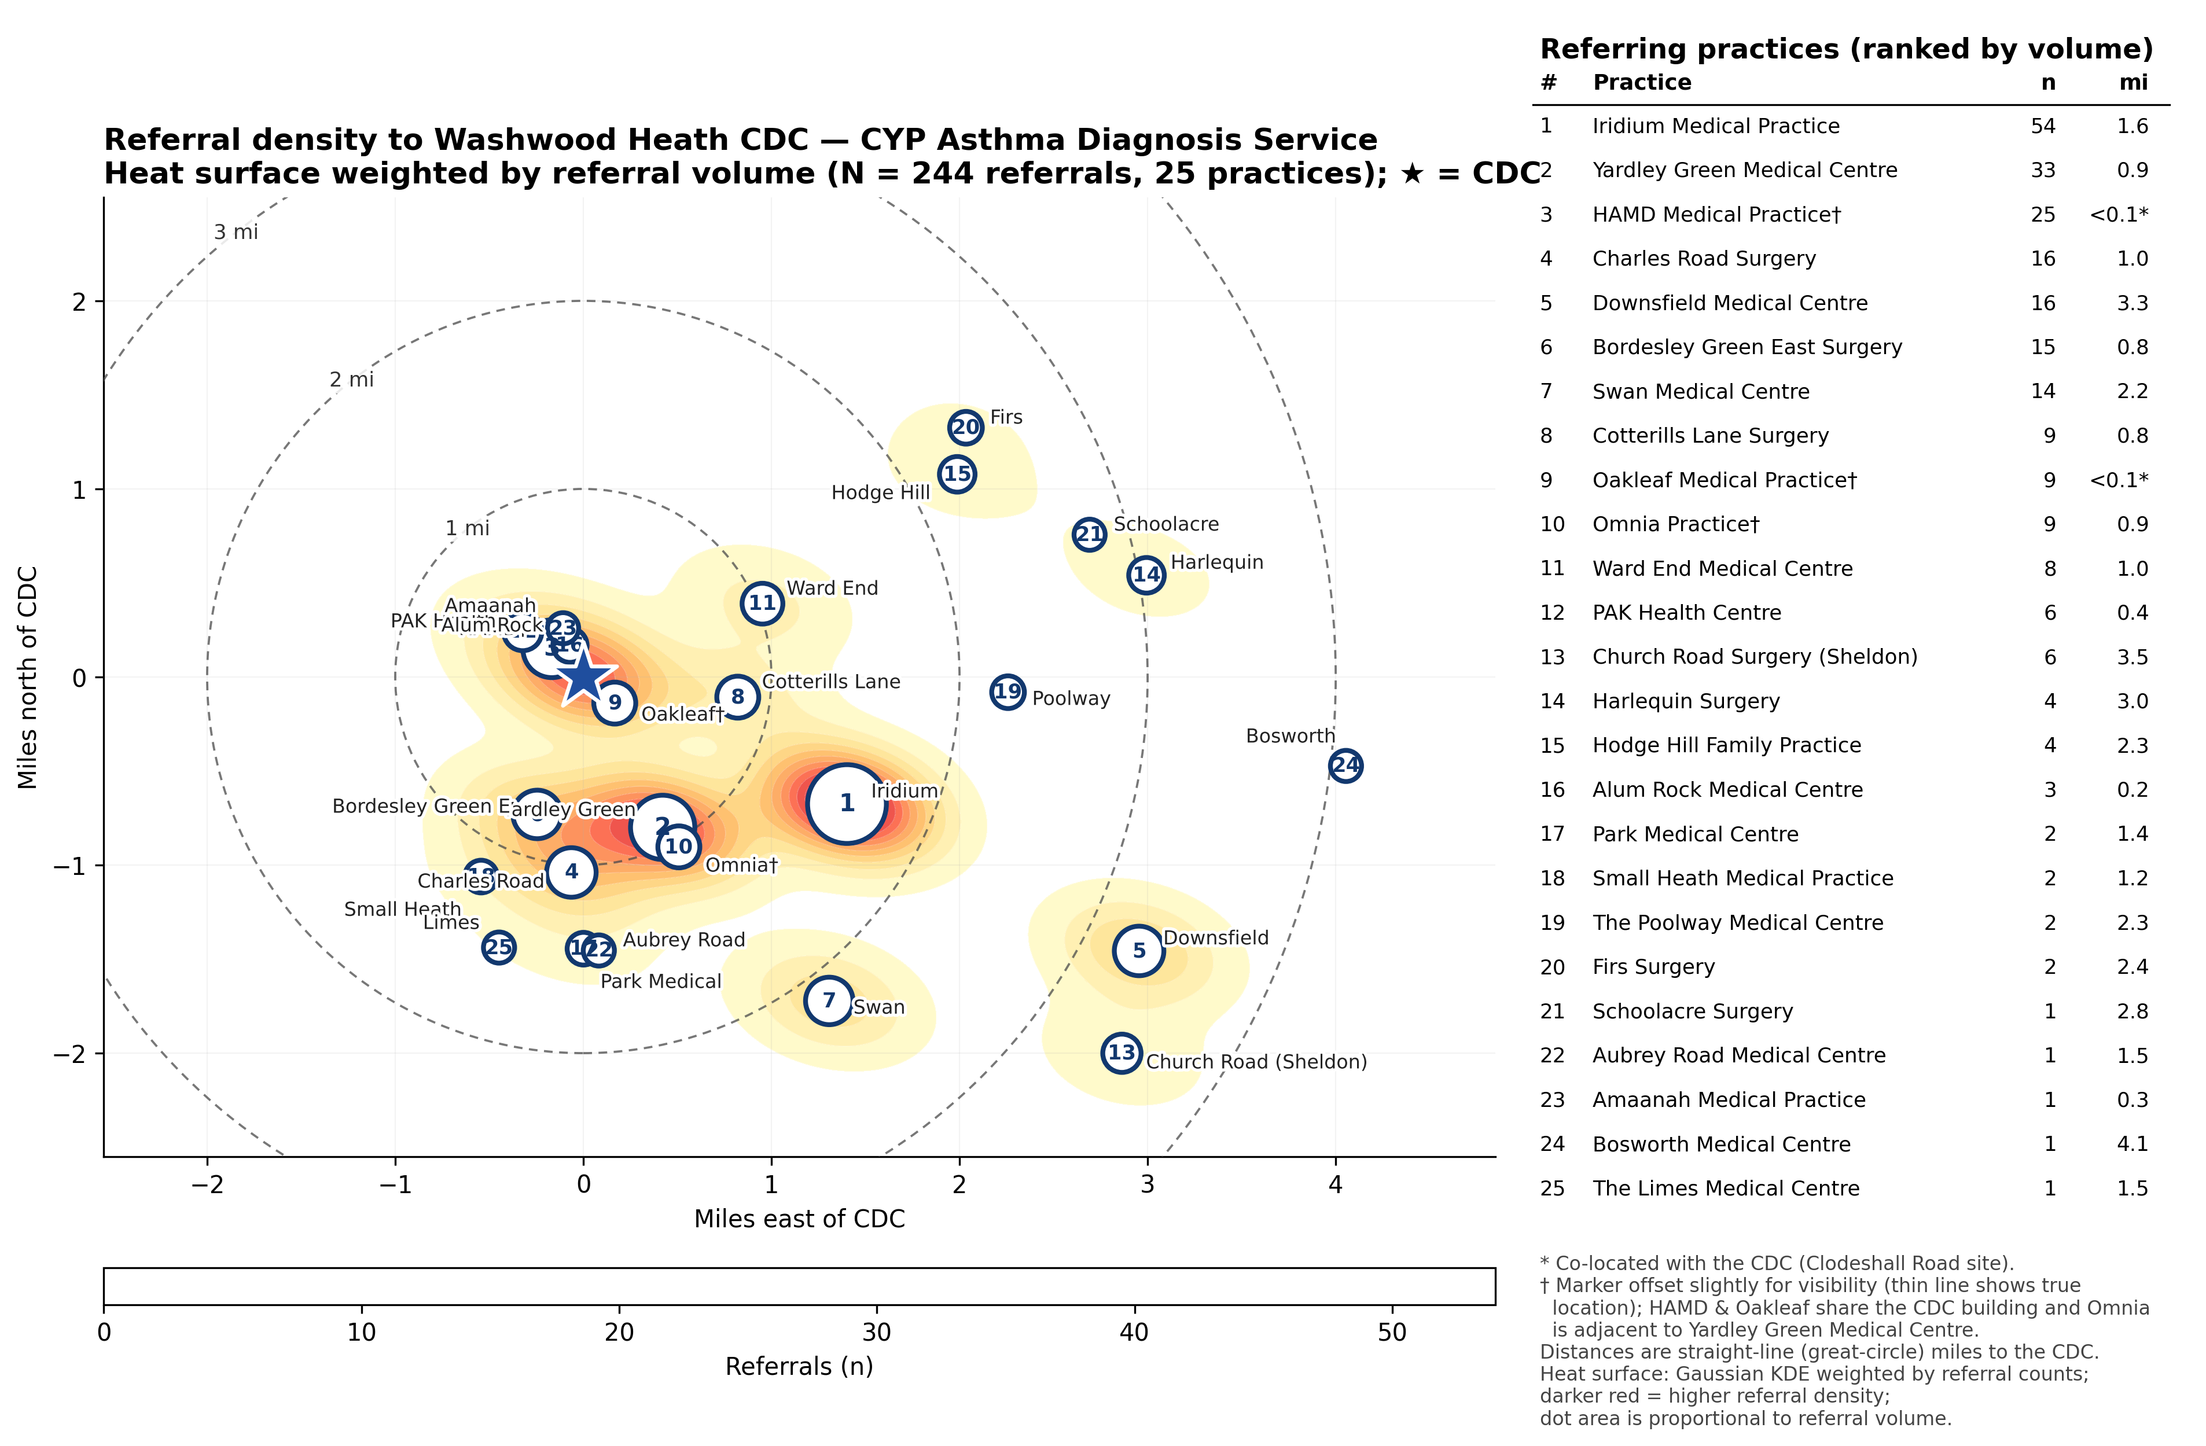

Slide 20
Next Steps: Service Expansion
Direct bookable service via eRS
All BSol GPs can refer patients
Alignment with CYP Integrated Neighbourhood Teams (INTs) and Neighbourhood Health strategy
Community prescribing platform

Slide 21


