Slide 1

Sandwell Public Health
Healthy Place Team

Slide 2

Choices Management Team
Lyndsey Smalley- Healthy Weight lyndsey_smalley@sandwell.gov.uk
Mandy Williams – Physical Activity mandy_williams@sandwell.gov.uk
Nicole Robins - Food and Nutrition Nicole_robins@sandwell.gov.uk
Choices inbox – choices_sandwell@sandwell.gov.uk

Slide 3
Sandwell at a glance
Sandwell is 19th most deprived LA in England
Sandwell has higher than average overweight people
More inactive people
Lower income
Higher global majority population
Poorer health outcomes

Slide 4
Sandwell NCMP 24-25
Sandwell’s NCMP results are on a negative trend
Sandwell overall is statistically worse than England
On average for the past three years, 570 reception age pupils per year were classed as obese (including Severe Obesity)
On average 1,405 Year 6 pupils per year were classed as being Obese
5 Years combined data shows that 31% of children measured in reception at a healthy weight were measured as overweight in y6
We also have an issue with underweight children
Source - fingertips

Slide 5
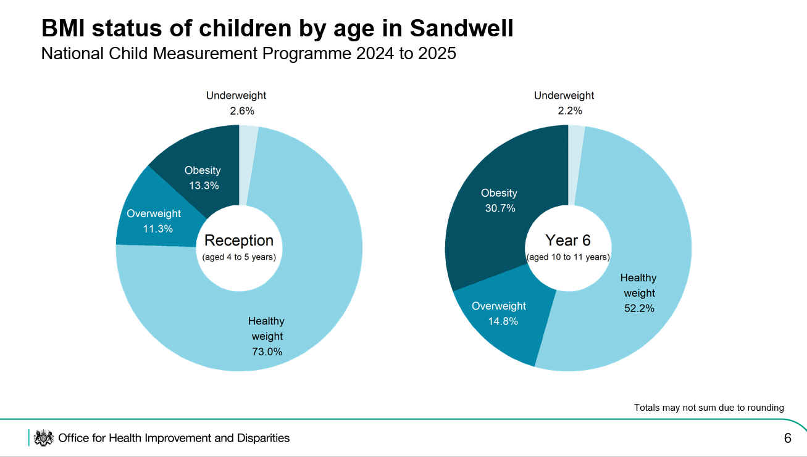
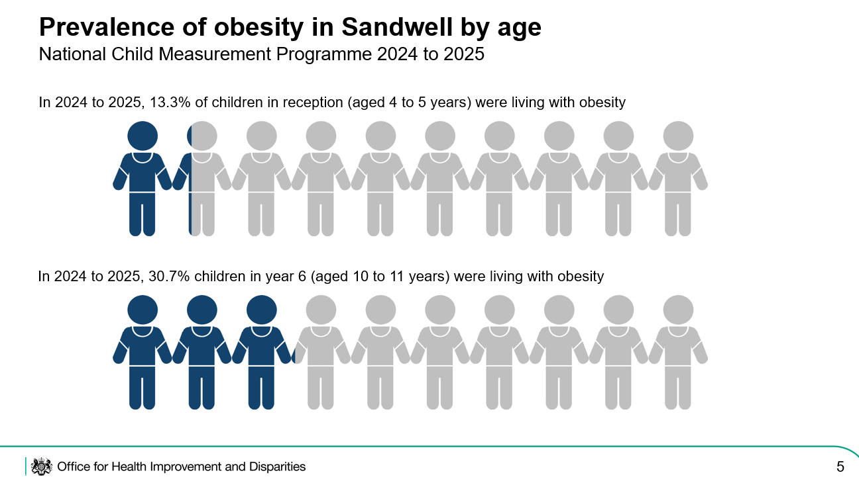
2024-2025 NCMP Data

Slide 6
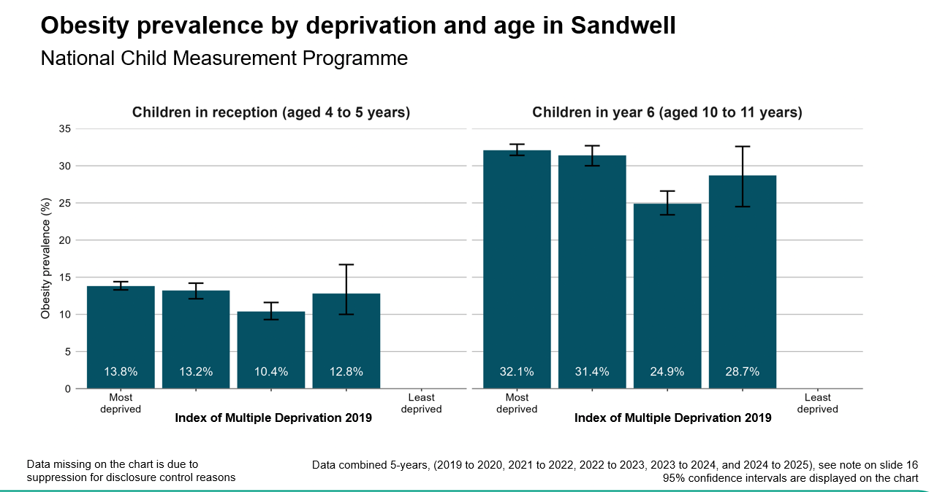

Slide 7
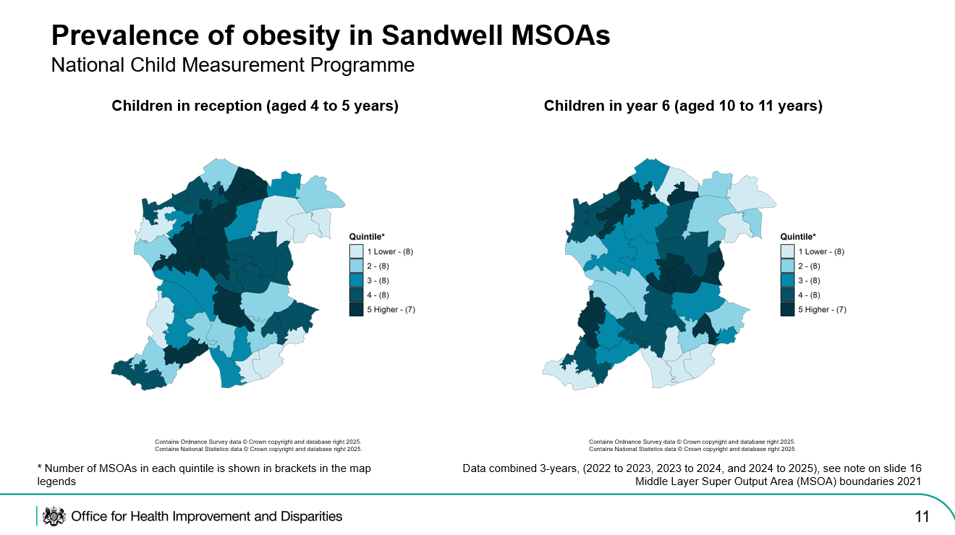
Reception and Year 6 obesity heat map

Slide 8
A New Approach was needed
Past schemes and approaches have not reversed the trend
It was recognised that
Lots of education for children
Lots of opportunities for adults
Nothing for families to make a change together

Slide 9
Choices:
A New Approach & Style
In-house team of three staff in place to support schools, families and communities from a holistic approach.
Taking a family centred approach to create healthier people and places -including older and younger siblings (subject to age appropriate activities)
Delivering a range of activities, food and wellbeing opportunities to make family memories – no mention of health, weight etc
Created in consultation with stakeholders including school nurses

Slide 10
How Choices works in Practice
NCMP data focusses the service to priority schools & wards
Flexible to demands and changes with need
Family led service – collaborative approach
All family members participate in the activities together
Learn as we go – and adjust as needed
Expertise within the team to deliver variety of activities to differing communities
Budget for delivery and partners to support
Use bookwhen for all activities – gives data & evidence of users accessing services
Link into wider PH priorities – oral health, sugar smart, mental well being
Work with wider partners – internal & external
All activities are free to access
The Choices team now deliver the community T2 service – further embedding their presence and expertise in the local community

Slide 11
Who can access Choices?
Families of children aged 5-12 who live, school or have a GP in Sandwell
% of places for school nurse referrals (98th centile)
% of places for any Sandwell family to access (live, attend school or GP in Sandwell)
Removing stigma of only being for referred families
Some sessions are for targeted schools / families only (book when password protected)
Places allocated via school nurses, Book When web pages or Healthy Sandwell team

Slide 12
Choices delivery framework
4 Key Project Themes
Food & Nutrition
Physical Activity
Growing Your Own
Emotional Health and Wellbeing

Slide 13
Sandwell Healthy Weight Offer
Choices age 5-12
Secondary schools
age 11-18
Adult referral pathways
18+
Family hubs & Changes programme age 0-5

Slide 14
Sandwell’s Healthy Lifestyle Referral Pathways
Choices
11-18 Healthy Weight
Adults 18+
Family Programme
5-12 primary age children
School nurses ID 98th+
GP
↓
Choices
↓
Open Access programme
(Next step)
Choices 8 wk targeted programme
Child only or Family Programme
Secondary school age
GP Choices
↓
Child healthy weight project (8 weeks)
↓
12 wk PA/HW project
↓
Leisure offer
Community offer
Referral into Adult only
or Family Programme
Tier 2 Livewell 12 wk plan
GP → Choices (family) or Tier 2 Livewell
NHS Rehab
Self referral
↓
• Leisure offer
• Community offer
↓
• Exercise Referral
➜
➜

Slide 15
Choices Yr 1
NCMP data focusses the service to priority schools & wards – however, in 23-24 every primary school in Sandwell (except one) was above England average for the proportion of overweight and obese children.
Initially, we approached the ten schools with poorest results and delivered in those schools or community venues in the area
As the word spread about our programme, schools started to approach us to deliver in their schools
Holiday programmes were key to engaging families
Over the first nine months of delivery, we offered 284 activities with around 3000 attendances from our families
390 families accessed our programme in yr 1, with 310 continuing to book further sessions in yr 2

Slide 16
Choices Yr 2 Plans
Direct referrals from School Nurses for a supported family programme for the top 1% - currently around 400 children
Pilot an 8 week GP referral programme within a cluster of GP practices
Expand workshops in school and community venues – familiar and accessible centres
Expand cooking sessions beyond one or two venues – maps into latest food standards policy
Continue with open access opportunities in holidays and term time
Choices staff move from fixed term to permanent roles
Learning from Choices has informed new T2 delivery partnership with Kore Leisure Centres & community delivery
Other LA’s have enquired about our Choices model

Slide 17
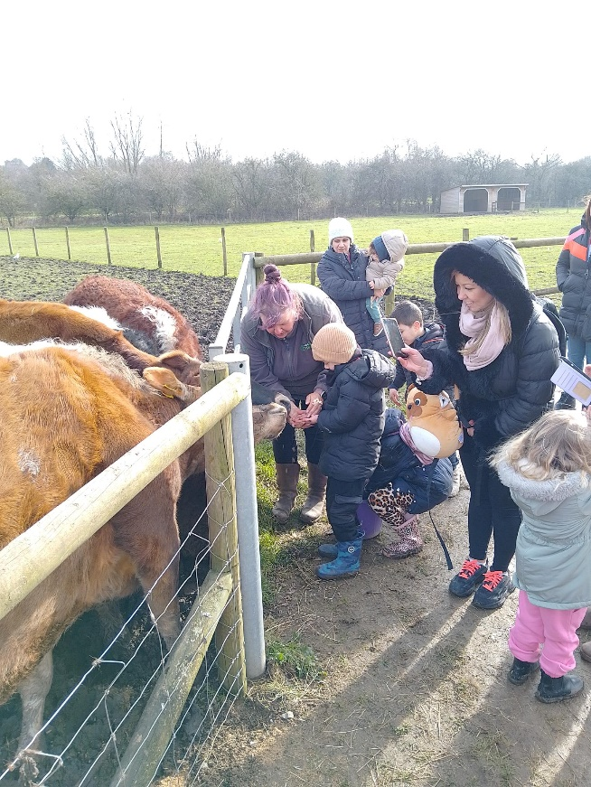
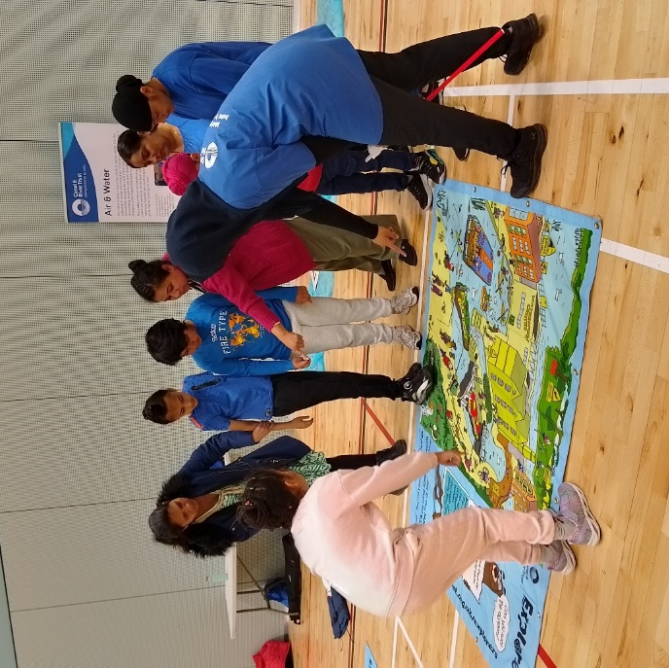
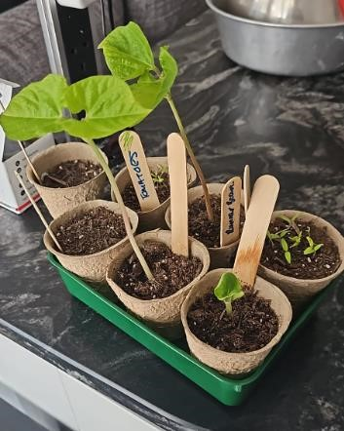
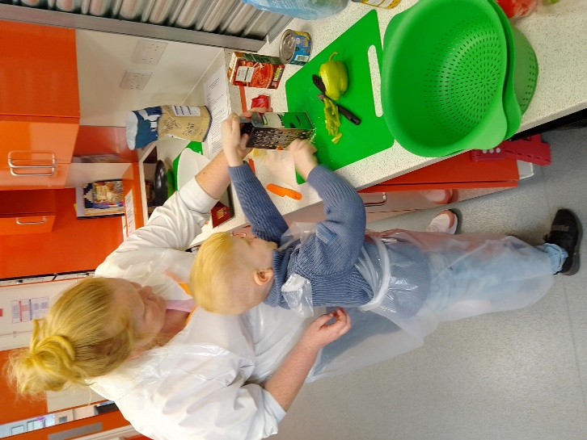
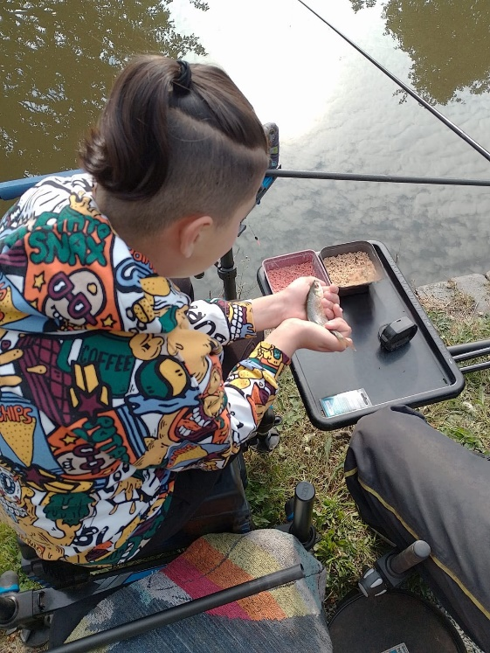
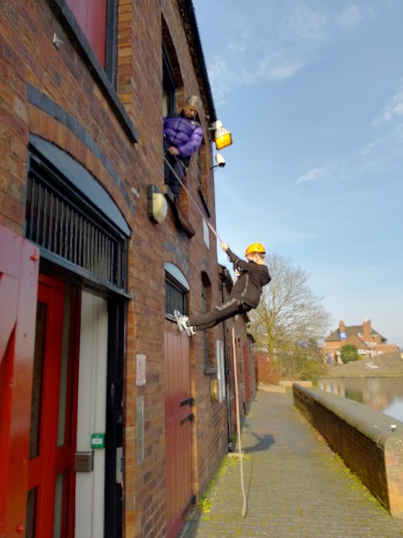


Slide 18
As reception NCMP results show, work is needed at pre-school age:
Early years offer
Family Hubs
services and support for all families in Sandwell with children aged 0 to 19 (or 25 with SEND) and extra support is available for families during pregnancy and in your baby’s first years.
https://www.sandwellfamilyhubs.com/
Changes
Changes programmes help parents throughout their parenting journey, starting from Antenatal.
Booking https://bookwhen.com/book4changes#focus=ev-sbwq-20250114113000
Choices continues the journey from Family Hubs and Changes

Slide 19
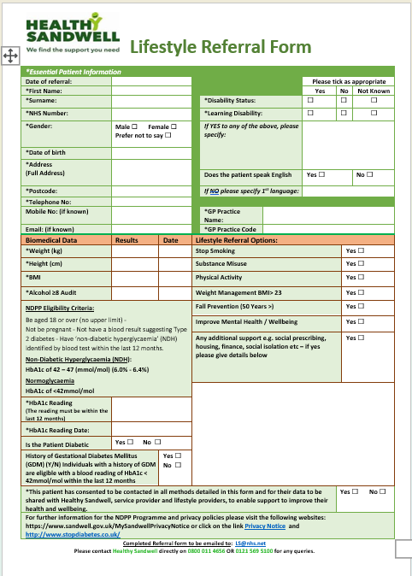
How to access Healthy Lifestyle Services
Our referral form is embedded into the clinical systems at GP practices. School Nurses refer in or anyone can complete a Healthy Sandwell enquiry form online https://www.healthysandwell.co.uk/contact-us/
Healthy Sandwell contact: 0800 011 4656 or 0121 569 5100
Email LS@nhs.net
Choices webpage https://www.healthysandwell.co.uk/choices/
Choices booking page https://bookwhen.com/choices

Slide 20
Choices Video links
Meet our Choices Team for free family activities in Sandwell! – YouTube
Choices Case Study

Slide 21
Any questions?

Slide 22


