Slide 1

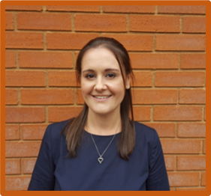
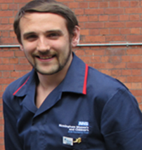
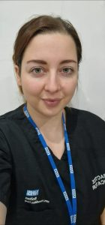
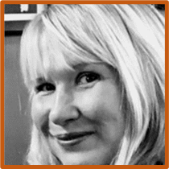
Paediatric Educators Network - Supporting Opportunities
(PENSO)
Gemma Williams
Louis Britton
Becky Sandiford
Wendy Hart
Catherine Munsey

Slide 2


To allow a confidential forum for developing operational, educational, and strategic multi-professional issues that has an impact on education/clinical teaching
To facilitate an environment for discussion on professional, educational, managerial, and other relevant issues associated with education
Allow Paediatric Educators across trusts throughout the United Kingdom to support, share and network to provide high-quality education to those in clinical areas and offer support and guidance to others in paediatric education
To allow a confidential forum for developing operational, educational, and strategic multi-professional issues that has an impact on education/clinical teaching
OVERALL AIMS
To network and collaborate with the multidisciplinary team and other interested agencies
Want to know more?
Scan me
To discuss new nursing developments, policies and national initiatives and examine how these may impact our roles and responsibilities operationally and strategically
To raise profile of paediatric clinical education across the United Kingdom

