Slide 1

Young Person's Advisory Group

Slide 2
YPAG is an indispensable group of passionate young people aged between 10-22. We represent the diverse voice of young people to ensure that our opinions and contributions are heard and acted on.
Our primary objective is to advocate the voice of young people. We express our views while actively being involved in the improvement of healthcare services across the Trust and beyond.

Slide 3



YPAG Projects

Slide 4

Research and Outreach
ELSA
Immense
CEW
Mental Health
SEND
Community Research
Co-Production
Youth developed training

Slide 5


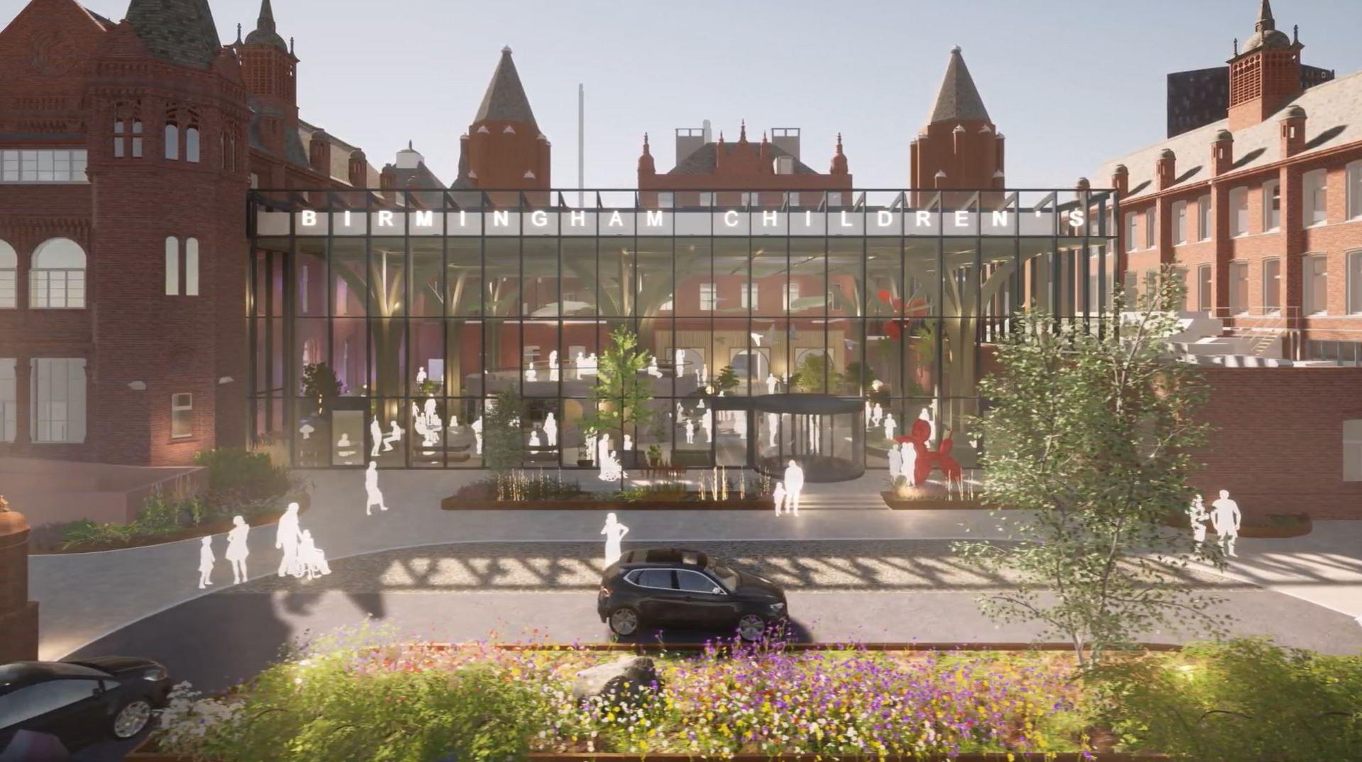
Infrastructure

Slide 6

Over to the important people – Ananya, Jawahir and Olivia

