Slide 1

Martha’s Rule
West Midlands Children’s Network Pilot
13th October
Sian Duckett
Deputy Lead Nurse

Slide 2
What is Martha’s Rule?
3 Operational Delivery Networks in England were allocated funding by NHS England to trial a pilot solution to implementing Martha’s Rule in paediatric acute inpatient areas:
West Midlands
North Thames
Yorkshire and Humber.
All NHS staff must have 24/7 access to a rapid review from a different team, if they feel they are not being listened to.
Patients and families must also have access to the same facility, advertised across the hospital.
Patients will be asked at least daily: how they are feeling and if they are better or worse – this will be acted upon in a structured way.

Slide 3
Pilot Project Overview
1. Develop Martha’s Rule response for paeds within existing skill & resource
2. Assess & trial willingness and availability of adult CCOT teams to provide paediatric reviews
3. Scoped and assessed current provision and develop resources & education
4. Sustainability – future resources, retaining skill, support with surge periods

Slide 4

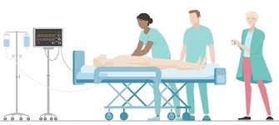


Pilot Project Overview
1. Advanced Communication Training
2. Paediatric Clinical Education & Simulation
3. Peer support & facilitation
4. Parent Engagement

Slide 5
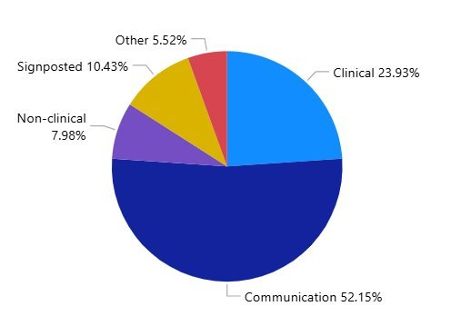

Advanced Communication Training
Interactive study day including role play, scenarios tailored to Martha’s Rule – Including: asking parent/carer question, escalating a concern & receiving a Call for Concern
Available to any professionals involved with Martha’s Rule process
Delivered in collaboration with Reach Communications and parent representative from Sepsis Trust
96% of candidates felt the day met their expectations and learning objectives
86% Of candidates reported increased confidence in their ability to have challenging conversations
208 Participants accessed the study day from 14 trusts (April 2025 – May 2026
(3x Trusts out of West Mids region and 2 NHS Scotland)

Slide 6

RAPID Study Day
Recognising and Assessing Paediatric Illness and Deterioration
Developed in collaboration with regional CCOT staff
‘What do you need to know?’ ‘What scares you?’
Study days covering paediatric anatomy, clinical skills, equipment & A-E assessment
Delivered in a relaxed engaging way to build confidence and a safe space to ask questions
Deteriorating patient scenarios including – Sepsis, DKA, Surgical emergencies & Trauma
To advocate for child
95 % of participants felt that they would be fully confident in assessing a deteriorating child
67 Participants accessed the study day from 5 trusts over 12 Study Days

Slide 7
Engagement
CCOT
Initial Concerns:​
Fear of missing symptoms due to lack of paediatric clinical exposure​
Remembering paediatric normal parameters​
Governance & Liability​
​
Support Provided:​
Shadow shifts’ with CCOT to gain exposure to their daily activity​
Peer support
Education
PPV
Acute Inpatient Areas
All pilot sites visited
Network team members met with patients and families
Discussed awareness and understanding of Martha’s Rule ​​
​​
Patients shared how they would want to know about Martha’s Rule
How they would escalate a worry themselves​​
​​
PVV
Community
Attendance at charity and public forums including minority and neurodiverse groups ​​​
​​​
CYP Engagement sessions ​​​
​​​
Dudley Youth Health Champions – Development of digital resource/video for CYP ​​
​​

Slide 8
Successes.....
Positive feedback from teams: Pilot model & project work effective and sustainable approach for Paediatrics ​
​
Digital Resource developed in collaboration with Dudley Youth Health Champions to be made available and adaptable by all trusts as a national resource​
​
RAPID Study Days to be developed into a national resource, endorsed by National Outreach Forum ​
​
Enthusiasm for the advanced communication days to be nationally accessible.
65% of West Midlands Trust have adopted the pilot approach

Slide 9
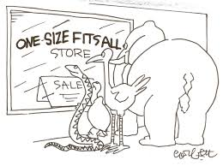
Pilot Challenges
One size does not fit all….. This approach was not adopted by all trusts, with some developing responses with anaesthetic teams, or within paediatric teams.
Culture – Not all CCOT had previous exposure to Paediatrics. Transition into this area was new and had expected associated anxieties

Slide 10





Opportunities
Opportunities…
Little……
but……
L O U D !

Slide 11
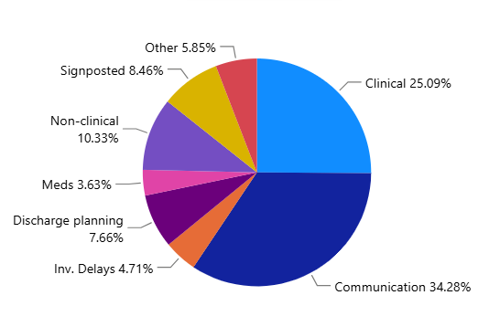
Paediatric calls October 2025 – June 2026
100 calls across WM and EM
Paediatrics 3.6% of total calls
34% Communication
3 patients escalated to PICU/HDU following a call

Slide 12
What happens now?
Pilot funding has now ended……
Further work with National Outreach Forum – Development of paediatric framework for adult trained staff
Grow the availability of RAPID days
Close of project report and dissemination
Completion and sharing of digital resource
Support with sustainability of pilot within sites within current resources

Slide 13









