Slide 1

Deteriorating patients and Martha’s rule in paediatrics
Siân Annakin
Deteriorating Patient Lead

Slide 2



Learning outcomes
Deteriorating Patient Pathway
Who responds?
Staff development

Slide 3

Deteriorating Patient Pathway
Sepsis
IDENTIFY
ESCALATE
RESPOND
NEWS2, NPEWS, MEWS or
Patient wellness question
Flowsheet
Escalation Document
Senior Review Document
PREVENT
Individualised EWS order; GSF, Treatment Escalation Plan

Slide 4
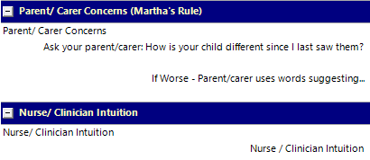


Does your paediatric patient show any of these signs of deterioration?
Soft Signs can be early signs of deterioration identifiable before NPEWS triggers
Is irritable and will not settle
Has a high pitched or abnormal cry
Is less responsive or floppy, difficult to wake
If YES,
record concerns in Sunrise vital signs – how worried are you/they?
Take observations
Speak to the nurse in charge
Activate the DPP if appropriate: escalate the patient
Increasing breathlessness
Grunting or wheezing
Increasing oxygen requirement
Reduced urine output or blood in stool
Is not interested in feeding/drinking or eating
d
Has a temperature – sweating or feels hot or cold to the touch
Skin changes – pale, rash, sores/blisters
PREVENT
IDENTIFY
ESCALATE
RESPOND

Slide 5
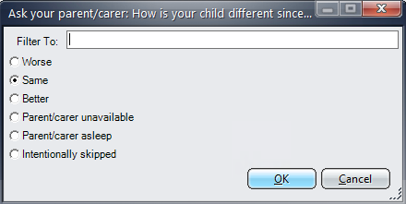
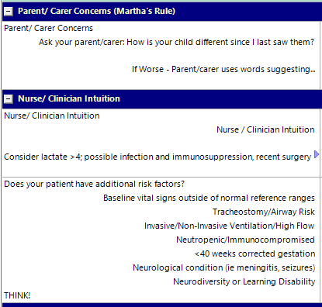
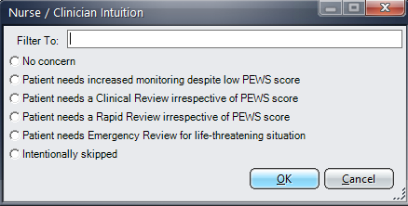
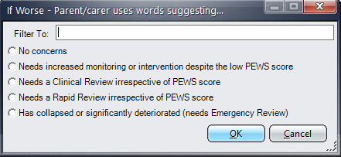
Patient Wellness Questions

Slide 6

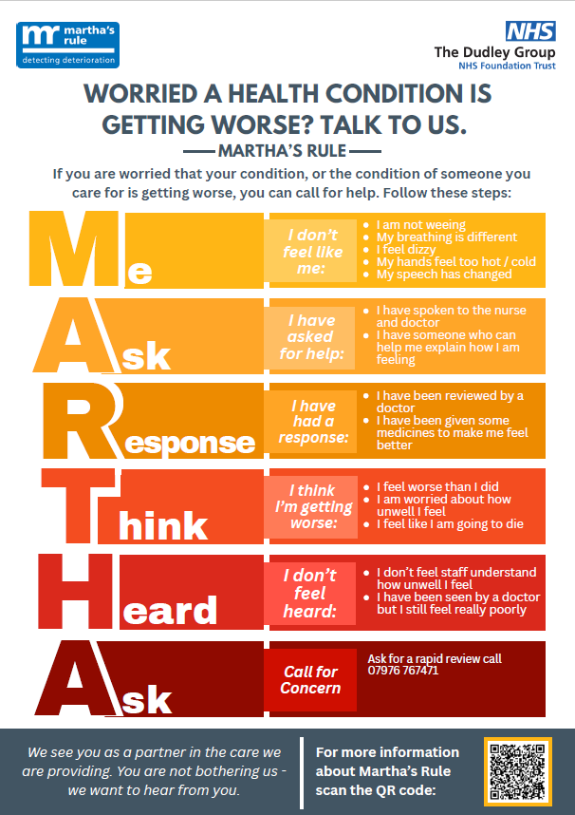
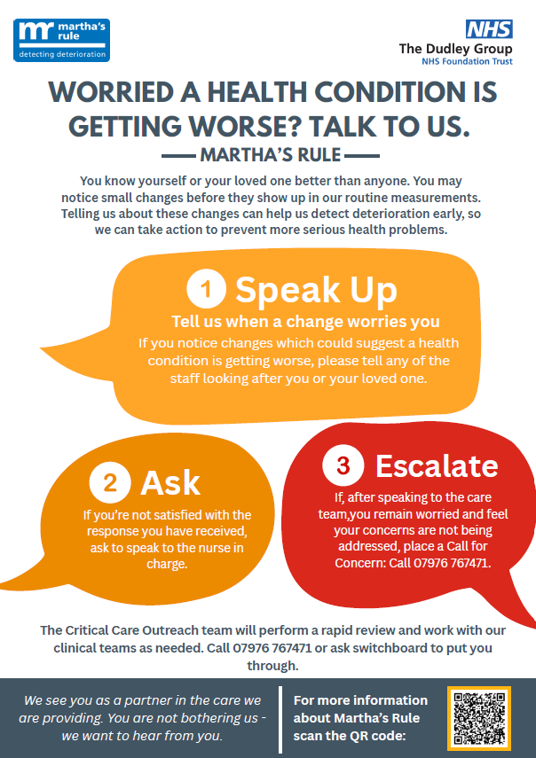
Call for concern

Slide 7
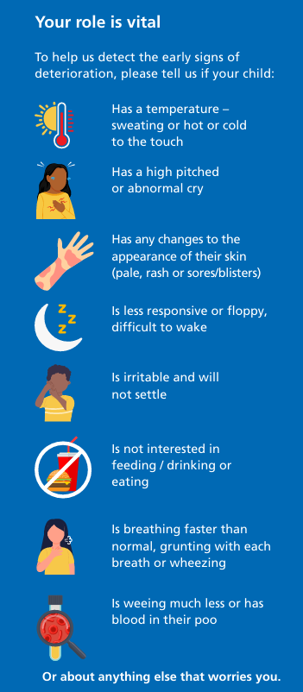
Launching Martha’s rule
Trust wide launch via EPR
Communication team plan
Freebies!
Pens, mouse mats, sweets, fob watches, cakes etc
Trolley of knowledge & information stands
Posters, banners, public resources, staff resources
Bedside stickers with QR codes
Support from the Critical Care Children’s network team
Education
Audit

Slide 8

Paediatric medical emergency team
Paediatric registrar
EPALS or APLS
Annual mandatory training
Paediatric SHO
EPALS or APLS
Annual mandatory training
Critical care doctor
EPALS or APLS
Annual mandatory training
Critical Care Outreach
EPALS
Annual mandatory training
Simulation
Simulation
Simulation
Simulation

Slide 9
CCOTeam
Critical Care Outreach
24/7
All work on unit as well as CCOT
Attend 2222 paediatric calls & referrals
24/7 Call for concern
Additional skills or qualifications
Critical care course
Non-medical prescribers
Additional annual training
Paediatric sim within the critical care unit from CCOT EPALS instructors
EPALS & ALS providers (requirements to hold a 2222 bleep)
Paediatric critical care transfer course
Annual critical care paediatric study days
How to convert an adult bed space to a paediatric one
Ventilator set up
ETT tying
MDT paediatric sim in ED & sim lab
Annual mandatory resus training

Slide 10


Additional team member skills
Paediatric ward nurses
≥ band 6
Annual mandatory training
Paediatric ED nurses
≥ band 6
EPALS
Deteriorating Patient Team
EPALS instructor or EPALS provider & PILS instructor
NLS providers
EPALS
Band 5
Annual PILS
Annual mandatory training
Band 5
Annual PILS or mandatory training
MDT Simulation in ED
MDT simulation on ward or in sim lab
Deliver RADAR programme (Recognise Acute Deterioration, Action & ReSPECT)
Additional staff (not core 2222 team members)

Slide 11
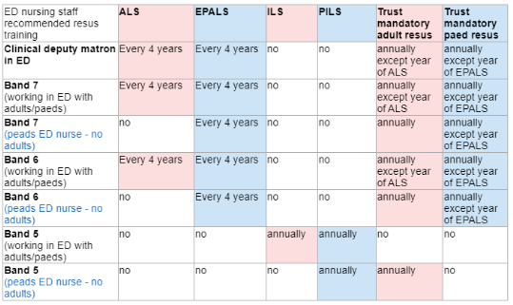
Staff development
Paediatric ward nurses
Deteriorating Patient Pathway training on ward
Paediatric ED nurses
Focus fortnight safety huddles with DPT
Deteriorating Patient Pathway training in ED
NPEWS
Tracheostomy care
Equipment recognition
Additional scenarios with skills embedded
Skills session as a bolt on to ePILS
Annual skills days
Opportunity to join monthly MDT sims on ward
Skills session as a bolt on to ePILS
Bite size learning refreshers
MDT sim within ED
Recommendations for ED nursing staff resus training

Slide 12
Summary
Prevent
Escalate
Response
Identify
Deteriorating Patient Team: dgft.dpt@nhs.net Follow us on X: @resusdudley

