Slide 1
Martha's Rule at Dudley Collaboration with Paediatrics
Faiuna Haseeb
Consultant in Intensive Care Medicine

Slide 2
Intensive Care and Paediatrics
Collaboration – Adult ICM medical and nursing teams + paediatrics (Case to follow)
Level 3 deterioration – KIDS + PICU
Level 2 / HDU patients?
Stabilisation and de-escalation
EPALS
RAPT Resuscitation and Paediatric Team Training
Martha's Rule

Slide 3
Dudley C4C Jan 2026 to present
153 calls for 116 patients
12 categorised as acute deterioration = 7.8%
National acute deterioration is 17%
38% of calls relating to deterioration of a chronic condition
Approximately 60 mins of outreach time spent per call
Average number of calls per month 17 ??
National average is 5

Slide 4
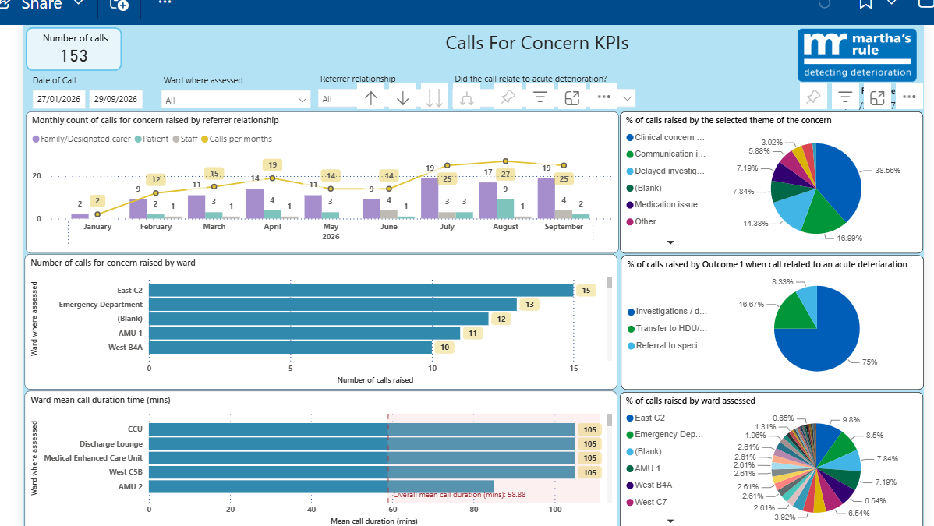

Slide 5
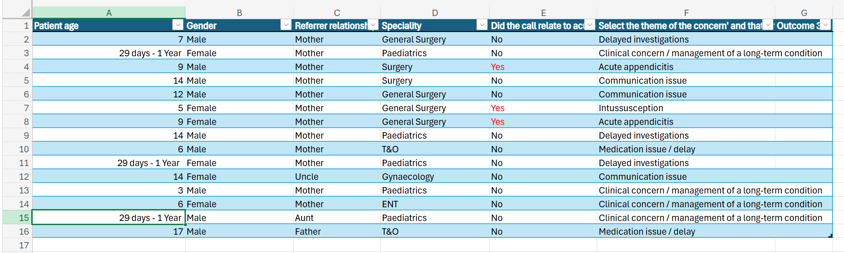
Paediatric C4Cs Jan 26 to present - Themes

Slide 6
Paediatric C4Cs Acute Deterioration
1. 9M (Surgery) Abdominal pain, vomiting. Escalated to surgical team. Laparoscopic appendicectomy performed (acute deterioration)
2. 5F (Surgery) abdominal pain, awaiting USS. C4C as parent told may need transfer depending on scan and scan not yet done . Paediatrics expedited scan. Diagnosis of intussusception, transferred to BCH (acute deterioration)
3. 9F (Surgery) abdominal pain discharged with open access to PAU. Returned within a few hours, severe pain. NIC and surgical ST contacted to organise analgesia. Appendicectomy performed (acute deterioration)

Slide 7
Paediatric C4Cs- Surgical Cases, no acute deterioration
14M ? Appendicitis. Mother felt that patient being sidelined. Dx: abdominal migraine (communication)
7F Abdominal pain, AXR awaited. Dx: constipation (delayed investigations)
12M ?Appendicitis, mother felt that not much had happened over 3 days of admission. Dx: viral infection. (communication)
14M Epilepsy, learning disabilities? Bowel obstruction. Mother concerned about missing medication. Clarified that antiepileptics to be given despite NBM. Dx: paralytic ileus (medication issue)

Slide 8
Paediatric C4Cs (no acute deterioration)
18 days F Neonatal thyrotoxicosis, maternal Graves disease. Mum wanted endocrinology update. (clinical concern re ongoing condition)
10 day M Bronchiolitis on HFO2. Parents wanted update on potential transfer to BCH . (clinical concern re ongoing condition)
3M D+V on IVI. Mother concerned about discharge. Discharge delayed to await passing urine (clinical concern re ongoing medical condition)
1 month F Vomiting and lethargy. Mum told that needs scan to exclude septic ileus. Mum worried about delay in transfer for contrast scan. Paediatric Dr spoke with Mum and BCH. Transferred for contrast scan and d/c back to RHH as NAD (delayed investigations)

Slide 9
Paediatric C4Cs (no acute deterioration)
14F (Gynae) Escalating abdominal pain. Family concerned about MDT outcome – for surgical removal of large ovarian cyst (communication)
5F (ENT) Parents concerned about facial swelling. ENT review, infected boil (clinical concern re ongoing medical condition)
6M and 17M (T&O) Analgesia (medication issue)

Slide 10
MDT CASE; Paediatrics, Adult ICM, ED
5 month M- emergency call put out in paediatric OP clinic. OP review for echo as left axis of heart seen on prenatal US
At 1600, 2222 put out by nurses as child appeared unwell. Attended by paediatrics + critical care, carried to paediatric ED
Hx; not feeding well, lethargic, D and V for 48 hours. Weight gain > 50th centile until now. Last was 7.5kg. Born at term, mother pre-eclamptic. Normal development. Echo at 3 months deferred, as too unsettled

Slide 11
Resuscitation Team; Paediatric Cons x 2, Paediatric ST7, Senior Paediatric Dr, Critical Care Cons, ST4 Anaesthetics, ED Paediatric Nursing Lead
Observations; HR 80 BP 112/50, cap refill 4-5 secs, cool and mottled, sats 99%, oxygen applied. Pus noted at urethral meatus
X 3 attempts prior to cannulation dorsum RH 24G (paediatric ST)
VBG; pH 6.93, pCO2 4, HCO3 6.2, BE –25, lactate 2, K 9.8, Na 110, glucose 14
Monitoring applied, HR intermittently 70, BMV ventilation by critical care
Fluid bolus 10ml/kg x 3
Hydrocortisone 25mg
1ml/kg of 8.4% NaHCO3
Cefotaxime
Hyperkalaemia treatment – limited by access, salbutamol nebuliser given, insulin and dextrose planned

Slide 12
Progress 1600- 1900
IO right tibia x 2 attempts by paediatric ST + ITU cons, unsuccessful placement. 3rd attempt paediatric cons, successful
Rpt Cap gas; pH 7.03, pCO2 4, HCO3 7.8, BE – 21, lactate 2.2, K 6.9, Na 115, glucose 12
HR 140, cap refill 3- 4s, colour improved and peripheries warmer
More alert, crying
Differential diagnoses ? CAH, Addisonian crisis precipitated by UTI
Critical care stepped down
ED nursing notes at 1950 and 2100, catheter in situ, urine dipstick, WCC ++, Hb ++, glucose +++, ketones -, x 3 vomit and loose stool, later breast feeding, settled

Slide 13
Discussion with BCH KIDS and Endocrinology
Discussion with KIDS BCH – Pre-renal failure, dehydration 2 to D+V. Need to r/o delayed presentation of CAH
Strict I+Os
Continue IV maintenance fluids (already started), hydrocortisone
Send basic metabolic profile
6 hourly U+Es
Endocrine advice - Pituitary screen - LH, FSH, TFT, Prolactin, 17-OHP, Testosterone, Androstenedione, Renin, Angiotensin
-USS KUB
-MRI Pituitary
-MRI adrenal
-Urine steroid profile
-Continue stress dose Hydrocortisone for 48 hours
-To discuss with endocrine tomorrow - update clinical situation

Slide 14
Admit to HDU RHH
Results 12 H later; U+Es: Na 128, Creatinine 57, Urea 19.8, K+ 5.5
Cap Gas: pH 7.1, CO2 3.63, O2 6.33, HCO3 9.1, BE -19.3, HB 61, Glucose 7.1, Ketones 0.5
Admission 11 days
Renal function, electrolytes and acidosis progressively improved with fluid replacement and supportive management. Returned to his normal baseline.
Urinary tract USS showed chronic left-sided pelvicalyceal dilatation with marked cortical thinning throughout the left kidney and a dilated tortuous left ureter.
MRI head and adrenals - No obvious adrenal pathology. Small pituitary - ? hyoplasia/pituitary insufficiency. MRI reports still need to be confirmed by paediatric radiologist
Discharged home with PAU access and endocrinology f/u

Slide 15
Learning Points
Complex paediatric pathology – unfamiliar to adult intensivists
Location
Team
Allocation of responsibility
Tertiary transfer not always possible/required
Follow up

